Slide 1
SHG Women Empowerment

Slide 2
Topics to be covered
Growth Mindset
Life Goals Setting
Time Management
Communications Skills
Stress & Emotions Management

Slide 3
Growth
Mindset

Slide 4
Importance To Have The Right Mindset
Fixed vs. Growth: The Two Basic Mindsets That Shape Our Lives
We need to learn how to self-talk ourselves to win every aspect of our lives, from love to money.
Everything we do in life has to do with our thinking. i.e. our mindset.

Slide 5
Importance To Have The Right Mindset
Our mind plays a very powerful role in what we believe and how we think. What we think about ourselves and our abilities decides how we act and lead our life.
What you believe is what you achieve. How you choose to interpret your experiences can set the boundaries on what you can accomplish.
There’s power in believing that you can improve and accomplish what you set out to achieve by looking at failures and setbacks as a medium for growth.

Slide 6
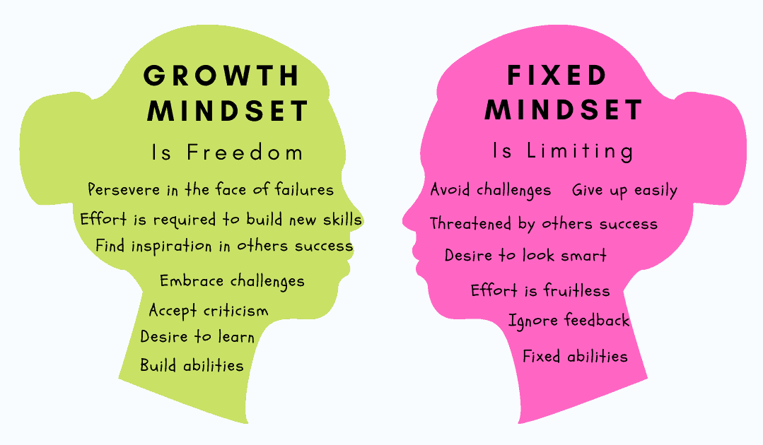

Slide 7
What is Fixed Mindset?
A person with a fixed mindset is constrained by their beliefs and thoughts. They believe people are born with special talents and every person has different abilities and intelligence that cannot get better with time, persistence and effort.
They think of failures as a validation of their lack of intelligence and their limited abilities that prevents them from achieving their goals. They give up easily with the fear of failure and a belief that they cannot improve.

Slide 8
What is Fixed Mindset?
In the workplace, fixed mindset shows up when we:
avoid constructive conflicts,
stick to existing solutions even when there’s a need to try new ideas,
do not speak up with the fear we might sound stupid,
refuse to take up a new challenge with uncharted territory,
blame others for not meeting our goals or
feel jealous of others success and growth.

Slide 9
What is Fixed Mindset?
It can make us:
show reluctance in making hard decisions,
avoid responsibility and
cripple innovation and collaboration.
Without learning skills essential for growth and development, we can only dream of success without ever realising it.

Slide 10
What is Growth Mindset?
A person with a growth mindset understand that certain people have special talents and that intelligence varies from person to person, but it’s also something that can be developed and increased with effort and hard work.
They take joy in the learning process that comes from seeking new information, forming new strategies, and taking inspiration from others. They embrace difficulties and challenges as a means to develop new skills and grow.

Slide 11
How to shift fixed mindset to a growth mindset
It’s not possible to apply a growth mindset all the time. The critical thing is to recognise important situations which can set off a fixed mindset and learn to switch to a growth mindset.
We all need to learn to shift:
from self doubt to potential for growth,
from worrying about the outcomes to taking interest in the process,
from a victim to adopting a role of a creator by taking responsibility and
from fear of failures to learning through them.

Slide 12
How to shift fixed mindset to a growth mindset
CHOOSE TO TELL YOURSELF A DIFFERENT STORY
Instead of telling yourself,
I am not good at it/ I can’t do it
I do not have the ability to learn
I give up because it’s beyond me
I have fixed potential/ I am who I am
Choose to say,
I can do better/ I can do it
I want to try and not give up
I believe in myself/ It’s possible only if I try
It’s ok to fail/ I can learn from my mistakes
Notes:
When we come across hard problems or difficult situations, how we react to them is based on our own story.

Slide 13
How to shift fixed mindset to a growth mindset
SET LEARNING GOALS
Commit to learning everyday as opposed to seeking goals that prove your worth. For example, instead of setting a goal to lose 30 kgs, commit to eating healthy everyday.
Focusing on the process as opposed to the outcome helps us look for small continuous improvements that add up over a period of time.
By shifting to learning, we can consciously choose a path in which hard work, effort, deliberate practice and persistence will be the key to success.
Success doesn’t come in a day. It’s a result of years of hard work in which learning never ends.

Slide 14
How to shift fixed mindset to a growth mindset
CHOOSE CONTINUOUS IMPROVEMENT
There’s a difference between seeking challenges and setting out to do what’s impractical. If you try to climb a mountain without building physical strength, there’s no way you can succeed.
You can set up a path for continuous improvement by slowly building upon your current abilities. Choose activities that are neither too easy nor too difficult, just a little over your current abilities. They provide a perfect opportunity to step outside your comfort zone without leading to anxiety.

Slide 15
How to shift fixed mindset to a growth mindset
BE CONSISTENT AND FLEXIBLE
You cannot shift from fixed mindset to a growth mindset in a day. Much like other things, it requires practice.
Be consistent in reflecting on your past behaviour by asking:
How did you act last time? Did you choose a fixed or a growth mindset?
What made you choose one mindset over the other?
Is there a pattern in events that makes you adopt a fixed mindset?

Slide 16
How to shift fixed mindset to a growth mindset
BE CONSISTENT AND FLEXIBLE
By asking yourself these questions on a regular basis and being flexible to learn from them, you can identify your fixed mindset trigger points and develop new strategies to adopt a growth mindset.

Slide 17
How to shift fixed mindset to a growth mindset
Let’s discuss what we can do.
Choose To Tell Yourself A Different Story
Set Learning Goals
Choose Continuous Improvement
Be Consistent And Flexible

Slide 19
Life Goals Setting

Slide 20
Life Goals Setting
Goals big and small can be the stepping-stones to a happier life and the way we set them can make a difference to achieving them.
In the first place, what are goals?
Goals are defined as the desired results you envision, plan and commit to achieve.

Slide 21
Life Goals Setting
So, what is the difference between goals and dreams?
Goals are dreams that come true after you have commited to act on your plans for your dreams.
Ask yourself these questions:
Where do you see yourself in 1, 3, 5 years from now?
How will your income and savings be like?
What will you be doing with your family?
How do you feel thinking of these?

Slide 22
Why are Life Goals Important?
Goals help us look forward in life by provide us with a direction of focus.
Goals help us to chart a plan for our future.
Goals motivate us to act on our plans.

Slide 23
What are some of your Life Goals?
We can plan for Short-Term, Medium Term & Long-Term goals.
Short-Term | Medium-Term | Long-Term
Eg. Go to KL, Malaysia for a 4 days holiday for next school holidays. | Eg. Save for a renovation of $20,000 in 3 years time. | Eg. Save for Children Education in 20 years time.

Slide 24
How do we set goals?
DECIDE
Think of something you want to do or work towards.
It doesn't matter what, as long as it's something you want to do - ideally something you're interested in or feel excited by.
It should be something you want to do for its own sake not for something or someone else.
It can be a big thing or a small thing - sometimes it is easier to get going with something small.
And it often helps if it's something that's just a little bit beyond what you currently can do - goals that stretch us can be motivating!

Slide 25
How do we set goals?
WRITE IT DOWN
Writing down our goals increases our chances of sticking with them.
Ask yourself: What it will 'look' like and how will you feel when you've done it? How does it connect to who or what you value in your life?
Describe your goal in specific terms and timescales e.g. “I want to plant lettuces, carrots and peas in the empty patch in my garden by the end of May”.
Write your goals in terms of what you want, not what you don't want e.g. “I want to be able to wear my favourite jeans again”.

Slide 26
How do we set goals?
TELL SOMEONE
Telling someone we know about our goals also seems to increase the likelihood that we will stick at them.
This is known as “accountability”.

Slide 27
How do we set goals?
BREAK YOUR GOAL DOWN
This is especially important for big goals.
Think about the smaller goals that are steps on the way to achieving your bigger aim. Sometimes our big goals are a bit vague, like 'I want to be healthier'. Breaking these down helps us be more specific. So a smaller goal might be 'go running regularly' or even 'to be able to run around the park in 20 minutes without stopping'.
Write down your smaller goals and try to set some dates to do these by too. Having several smaller goals makes each of them a bit easier and gives us a feeling of success along the way, which also makes it more likely that we'll stay on track towards our bigger goal.

Slide 28
How do we set goals?
PLAN YOUR FIRST STEP
An ancient Chinese proverb says that the journey of 1000 miles starts with one step.
Even if your goal isn't to walk 1000 miles, thinking about the first step on the way will really help to get you started.
Even if you don't know where to start there's no excuse - your first step could be to research 'how to…' on the internet or think of people you could ask or to get a book on the subject from the library.
Then think of your next step…and the next…

Slide 29
How do we set goals?
KEEP GOING
Working towards our goals can sometimes be difficult and frustrating - so we need to persevere.
If a step you're doing isn't working, think of something else you could try that still moves you forward, even a tiny bit.
If you're struggling, ask people you know for their ideas on what you could do. They may help you see a different way.
Thinking about different ways of reaching our goals makes it more likely we'll be successful.
If you're really struck - take a break and then re-read the goal you wrote down when you started. If you need to adjust your goal - that's ok too. Then have another thinking about the next step…

Slide 30
How do we set goals?
CELEBRATE
When you reach your goal take time to enjoy it and thank those that helped you.
Think about what you enjoyed and learned along the way.
Now, what is your next goal or project going to be?

Slide 31
Let’s set some goals
Please bring out a piece of paper and a pen.
Draw this.
Write down your goals.
Share with someone.
Types of Goal | What is your goal? | Why is this goal important to you? | When to achieve? | How to achieve?
Short Term
Medium Term
Long Term

Slide 33
Time Management

Slide 34
Time Management
“Time management” is the process of organising and planning how to divide your time between specific activities.
Good time management enables you to work smarter – not harder – so that you get more done in less time, even when time is tight and pressures are high.
Failing to manage your time damages your effectiveness and causes stress.

Slide 35
Benefits of Time Management
Achieve greater productivity and efficiency. You can accomplish more with less effort.
Reduce stress. When you don’t have control of your time, it’s easy to end up feeling rushed and overwhelmed.
Increased opportunities for job advancement. Get better pay.
More time to learn how to achieve important life goals. Spend more quality time with family.

Slide 36
4 Ds of Time Management
This is a popular strategy for deciding whether or not a task is worth your time.
It involves making a quick decision about what to act on now either by doing it yourself or delegating to someone else, what to act on in the future, or what to drop from your to-do list.
The 4 Ds are: Do, Defer (Delay), Delegate, and Delete (Drop). Placing a task into one of these categories helps you manage your limited time more effectively and stay focused on what matters most to you.

Slide 37
4 Ds of Time Management
DO Things that are urgent and need your personal attention, skills or knowledge. | DELEGATE Things that don’t need your personal attention, skills and knowledge OR someone can do a better job than yourself.
DEFER (DELAY) Things that are not urgent but important to complete. | DELETE (DROP) Things that are not urgent and not important at all.

Slide 38
Let’s do Time Management
Ask yourself how to use this.
DO Things that are urgent and need your personal attention, skills or knowledge. | DELEGATE Things that don’t need your personal attention, skills and knowledge OR someone can do a better job than yourself.
DEFER (DELAY) Things that are not urgent but important to complete. | DELETE (DROP) Things that are not urgent and not important at all.

Slide 40
Communications Skills

Slide 41
What are Communication Skills?
Being able to communicate effectively is one of the most important life skills to learn. Communications skills refer to your abilities to pass, receive and process information.
They allow you to make requests, ask questions, understand instructions, give direction and relay information with clarity and conciseness.
Good communication skills are essential in your professional and private life. The most common communication skills are listening, speaking and writing.

Slide 42
Why are Communication Skills important?
The ability to communicate effectively with people is essential, no matter where you are.
Successful communication helps us better understand people and situations.
It helps us overcome diversities, resolve conflicts, build trust and respect, and create conditions for sharing creative ideas and solving problems.

Slide 43
How to Communicate Effectively?
Listen To Understand
Keep An Open Mind & Ask Questions For Clarification
Don’t Interrupt
Take Time To Think Before Speaking
Look For Non-verbal Communication
Record Important Matters & Summarise

Slide 44
Listen To Understand
Listen actively to understand the other party’s situation.
Understand how the other party’s think, feel about the situation.
Reflect the other party’s response to the situation.

Slide 45
Keep An Open Mind & Ask Questions For Clarification
Do not judge the person, whether he/she is right or wrong first.
Best is to look at the situation from the big picture.
Ask questions to understand the full picture.

Slide 46
Don’t Interrupt
Do not interrupt when the other party is talking/sharing.
Interruption will not help you understand the situation.
Interruption may not respect the other party.

Slide 47
Take Time To Think Before Speaking
Saying the wrong thing, even at the right time, can seriously injure a person.
Words have power, so it is very important to learn how we communicate.
Therefore, take time to listen, be careful how you answer and take time before speaking.

Slide 48
Look For Non-verbal Communication
Non-verbal communication may speak louder than words, but they are not as distinct as words. Non-verbal communication includes:
Body language and posture
Facial expressions
Behavior
So be observant.

Slide 49
Record Important Matters & Summarise
People will feel that they are been respected and you are taking the conversation seriously.
People will be more willing to share with you.
Summarise your conversation so that you understand what was said.

Slide 50
Let’s recap and discuss
How to Communicate Effectively?
Listen To Understand
Keep An Open Mind & Ask Questions For Clarification
Don’t Interrupt
Take Time To Think Before Speaking
Look For Non-verbal Communication
Record Important Matters & Summarise

Slide 52
Stress & Emotions Management

Slide 53
Stress & Emotions Management
If you’re living with high levels of stress, you’re putting your entire well-being at risk. Stress wreaks havoc on your emotional equilibrium, as well as your physical health.
It narrows your ability to think clearly, function effectively, and enjoy life.
It may seem like there’s nothing you can do about stress. The bills won’t stop coming, there will never be more hours in the day, and your work and family responsibilities will always be demanding. But you have a lot more control than you might think.

Slide 54
Stress & Emotions Management
Effective stress management helps you break the hold stress has on your life, so you can be happier, healthier, and more productive.
The ultimate goal is a balanced life, with time for work, relationships, relaxation, and fun—and the resilience to hold up under pressure and meet challenges head on.
But stress management is not one-size-fits-all. That’s why it’s important to experiment and find out what works best for you.

Slide 55
Identify the sources of stress in your life
Stress management starts with identifying the sources of stress in your life.
Ask yourself:
Is it family or/and work?
Is it personal, financial, relationship, health issue?
Who is causing you the stress?

Slide 56
Practice the 4 A’s of stress management
The four A’s – Avoid, Alter, Adapt & Accept
AVOID
Learn how to say “no.” Know your limits and stick to them. Whether in your personal or professional life, taking on more than you can handle is a surefire recipe for stress.
Avoid people who stress you out. If someone consistently causes stress in your life, limit the amount of time you spend with that person, or end the relationship.

Slide 57
Practice the 4 A’s of stress management
The four A’s – Avoid, Alter, Adapt & Accept
ALTER
Express your feelings instead of bottling them up. If something or someone is bothering you, be more assertive and communicate your concerns in an open and respectful way.
Be willing to compromise. When you ask someone to change their behavior, be willing to do the same. If you both are willing to bend at least a little, you’ll have a good chance of finding a happy middle ground.

Slide 58
Practice the 4 A’s of stress management
The four A’s – Avoid, Alter, Adapt & Accept
ADAPT
Reframe problems. Try to view stressful situations from a more positive perspective.
Adjust your standards. Perfectionism is a major source of avoidable stress. Stop setting yourself up for failure by demanding perfection. Set reasonable standards for yourself and others, and learn to be okay with “good enough.”

Slide 59
Practice the 4 A’s of stress management
The four A’s – Avoid, Alter, Adapt & Accept
ACCEPT
Don’t try to control the uncontrollable. Many things in life are beyond our control, particularly the behavior of other people. Rather than stressing out over them, focus on the things you can control such as the way you choose to react to problems.
Learn to forgive. Accept the fact that we live in an imperfect world and that people make mistakes. Let go of anger and resentments. Free yourself from negative energy by forgiving and moving on.

Slide 60
Connect to others
There is nothing more calming than spending quality time with another human being who makes you feel safe and understood. So make it a point to connect regularly—and in person—with family and friends.
Keep in mind that the people you talk to don’t have to be able to fix your stress. They simply need to be good listeners. And try not to let worries about looking weak or being a burden keep you from opening up.

Slide 61
Make time for fun and relaxation
Set aside leisure time. Include rest and relaxation in your daily schedule. Don’t allow other obligations to encroach. This is your time to take a break from all responsibilities and recharge your batteries.
Do something you enjoy every day. Make time for leisure activities that bring you joy, whether it be listening to music, playing with games etc.

Slide 62
Maintain balance with a healthy lifestyle
Eat a healthy diet.
Reduce caffeine and sugar.
Avoid alcohol, cigarettes, and drugs.
Get enough sleep.

Slide 63
Let’s practice and discuss
Identify the sources of stress in your life
Practice the 4 A’s of stress management. The four A’s – Avoid, Alter, Adapt & Accept
Connect to others
Make time for fun and relaxation
Maintain balance with a healthy lifestyle

