Slide 1
Computer & Mobile Literacy Program
Microsoft Word Basic – Part 4: Page Formatting

Slide 2
Learning Objectives
To understand how to format the page
了解如何格式化页面

Slide 3
Format Page
Once you’ve filled a page with text, it’s time to step back and think about how that text appears on the page.
用文本填充页面后，是时候退一步考虑该文本在页面上的显示方式了。
When you format a page, you change how much of the page is covered in text as well as how that text flows through the page. In this class, you’ll learn how to adjust a page’s margins, size, and orientation.
设置页面格式时，您会更改文本覆盖页面的多少以及该文本在页面中的流动方式。在本课程中，您将学习如何调整页面的边距、大小和方向。

Slide 4
Format Page
You will also learn how to add content to the header and footer of a page, including page numbers.
您还将学习如何向页面的页眉和页脚添加内容，包括页码。
Finally, you will learn how to break text into columns, how to manually break between pages, and format what, if anything, appears on the page’s background.
最后，您将学习如何将文本分成几列，如何在页面之间手动断开，以及如何格式化页面背景上出现的内容（如果有的话）。

Slide 5
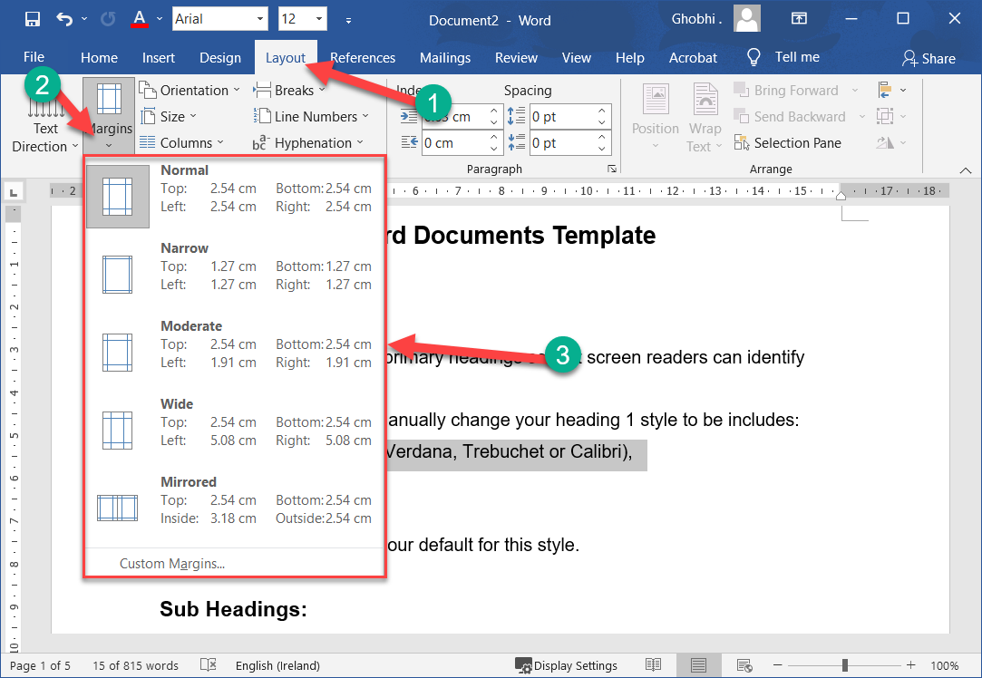
Adjust Margins
A margin is the empty space between a document’s contents and the edges of the page.
边距是文档内容和页面边缘之间的空白区域。
Word’s default margins are 1 inch on each side of the page, but you can change the margins to accommodate the needs of your document.
Word 页面每边的默认边距为 1 英寸，但您可以更改边距以适应文档的需要

Slide 6
Choose a Margin Size
Word includes several built-in margin settings that you can choose from.
Word 包含多种内置边距设置，您可以从中进行选择。
Click the Layout tab. |单击布局选项卡。
Click the Margins button. |单击边距按钮。

Slide 7
Choose a Margin Size
Select a new margin setting. Word adjusts the size of the margins and automatically redistributes your content to fit. | 选择新的边距设置。 Word 会调整边距的大小并自动重新分配您的内容以适应。

Slide 8
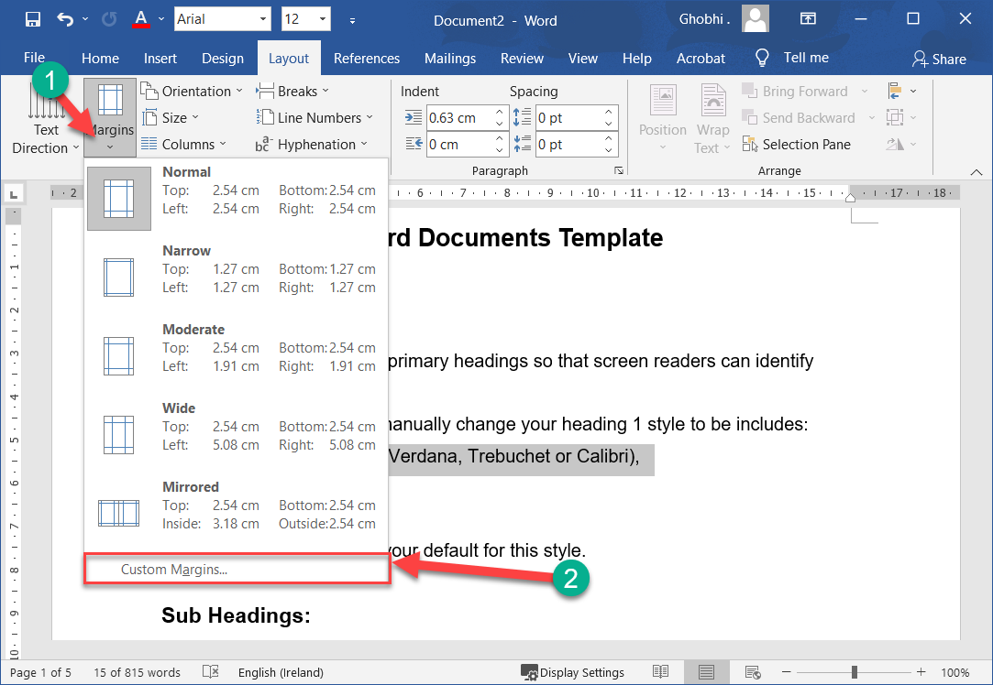
Set Custom Margins
If the common margin settings don't meet your needs, you can create custom ones.
如果常用边距设置不能满足您的需求，您可以创建自定义设置。
Click the Margins button on the Layout tab. |单击布局选项卡上的边距按钮。
Select Custom Margins. |选择自定义边距。

Slide 9
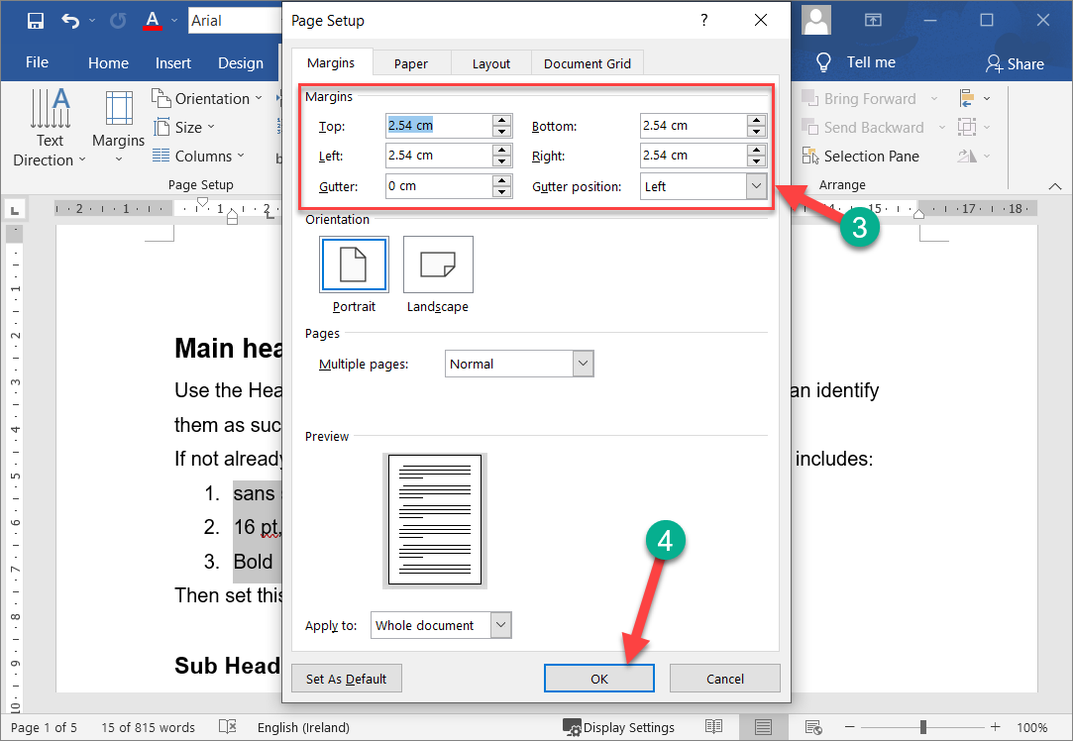
Set Custom Margins
Adjust your margin settings in the dialog box. |在对话框中调整边距设置。
Click OK. |单击确定。

Slide 10
Set Custom Margins
Another way to adjust margins is to click and drag the Left Margin, Right Margin, Top Margin, or Bottom Margin line on the Ruler.
另一种调整边距的方法是单击并拖动标尺上的左边距、右边距、上边距或下边距线。

Slide 11
Set Custom Margins
If you intend to bind a document and require extra space for the bindings, use the Gutter setting on the Margins tab in the Page Setup dialog box.
如果您打算装订文档并需要额外空间用于装订，请使用页面设置对话框中边距选项卡上的装订线设置。

Slide 12
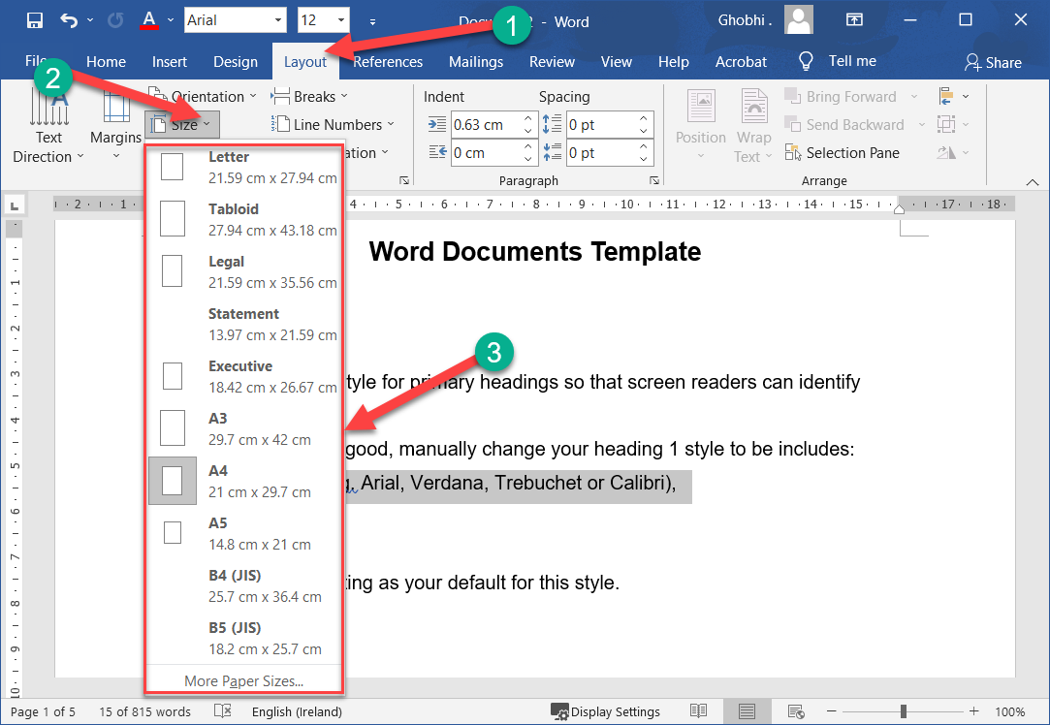
Page Size & Orientation
The page size and orientation are two of the most noticeable page layout properties of a document.
页面大小和方向是文档的两个最显着的页面布局属性

Slide 13
Page Size
Word can lay out the page for any paper size that your computer’s printer supports. This means that you can use Word not only to print letters, but also legal documents, postcards, tickets, flyers, and any other documents that use a non-standard paper size.

Slide 14
Page Size
Word 可以为计算机打印机支持的任何纸张尺寸布置页面。这意味着您不仅可以使用 Word 打印信件，还可以打印法律文档、明信片、门票、传单和任何其他使用非标准纸张尺寸的文档。

Slide 15
Page Size
Click the Layout tab. |单击布局选项卡。
Click the Size button. |单击大小按钮。
A list of common page sizes appears.
出现常用页面尺寸列表。

Slide 16
Page Size
Select the size you want to use. |选择您要使用的尺寸。
The document preview on the screen adjusts to use the selected paper size.
屏幕上的文档预览会调整为使用选定的纸张尺寸。

Slide 17
Page Size
If the size you want to use doesn’t appear in the list, select More Paper Sizes. The Paper tab of the Page Setup dialog box appears, where you can enter a custom paper size.
如果您要使用的尺寸没有出现在列表中，请选择更多纸张尺寸。出现页面设置对话框的纸张选项卡，您可以在其中输入自定义纸张尺寸。

Slide 18
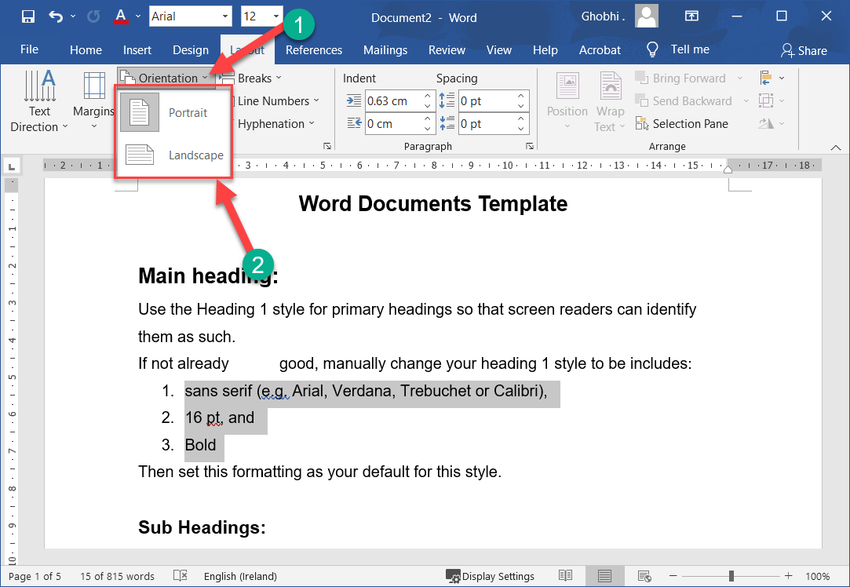
Page Orientation
Every document uses one of two different types of page orientations: Portrait and Landscape.
每个文档都使用两种不同类型的页面方向之一：纵向和横向。

Slide 19
Page Orientation
From the Layout tab, click Orientation. |从布局选项卡中，单击方向。
Select a page orientation: |选择页面方向：

Slide 20
Page Orientation
Portrait: The paper is taller than it is wide—like a portrait painting. This is the default orientation setting.
肖像：纸张的高度大于宽度——就像一幅肖像画。这是默认的方向设置。
Landscape: The paper is wider than it is tall—like a landscape painting.
风景：纸张宽于高——就像一幅山水画。

Slide 21
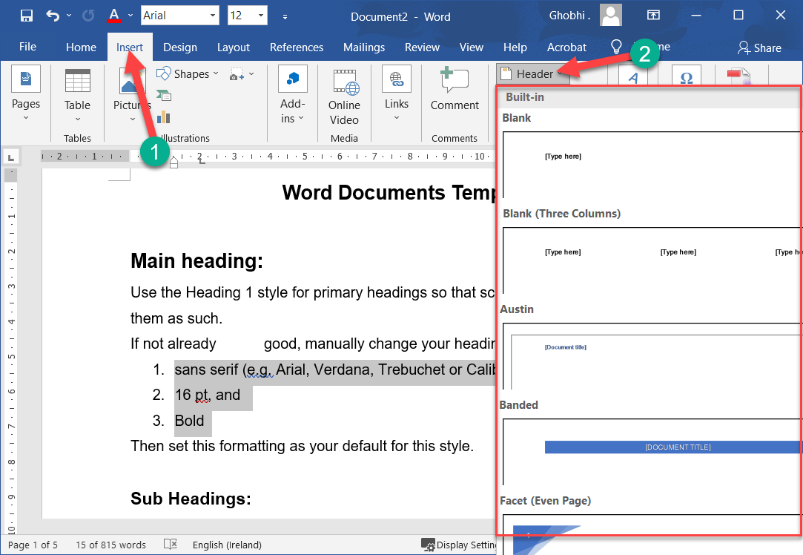
Headers & Footers
Documents with several pages often have information—such as the page number, the document’s title, or the date—located at the top or bottom of every page.
包含多页的文档通常在每一页的顶部或底部都有信息（例如页码、文档标题或日期）。

Slide 22
Headers & Footers
Text that appears at the top of every page in a document is called a header, while text appearing at the bottom of every page is called a footer.
出现在文档每一页顶部的文本称为页眉，而出现在每一页底部的文本称为页脚。

Slide 23
Headers & Footers
Click the Insert tab. |单击插入选项卡。
Click the Header or Footer button. | 单击页眉或页脚按钮。

Slide 24
Headers & Footers
A list of built-in header or footer designs appears. Each option will include one or more placeholders for information such as document title, date, or page number.
出现内置页眉或页脚设计列表。每个选项都将包含一个或多个信息占位符，例如文档标题、日期或页码。

Slide 25
Headers & Footers
Hover over a built-in header or footer option to view its attributes and a description of how it might be used best.
将鼠标悬停在内置页眉或页脚选项上可查看其属性以及如何最好地使用它的描述。

Slide 26
Headers & Footers
Select a built-in header or footer design. |选择内置页眉或页脚设计。
A new header or footer is inserted, and the Header and Footer Design tab also appears on the ribbon.
将插入新的页眉或页脚，并且功能区上也会显示页眉和页脚设计选项卡。

Slide 27
Headers & Footers
Click the Close Header and Footer button when you’re done. |完成后单击关闭页眉和页脚按钮。
The Header and Footer Design tab closes, and the header and footer are set.
页眉和页脚设计选项卡关闭，并设置页眉和页脚。

Slide 28
Remove Header & Footer
Once you’ve added a header or footer, you can easily remove it if you find that it isn’t what you want.
添加页眉或页脚后，如果您发现它不是您想要的，则可以轻松将其删除。
Click the Header or Footer button on the Insert tab. | 单击“插入”选项卡上的“页眉”或“页脚”按钮。

Slide 29
Remove Header & Footer
Select Remove Header or Remove Footer. |选择删除页眉或删除页脚。
The header or footer is removed.
页眉或页脚被删除。

Slide 30
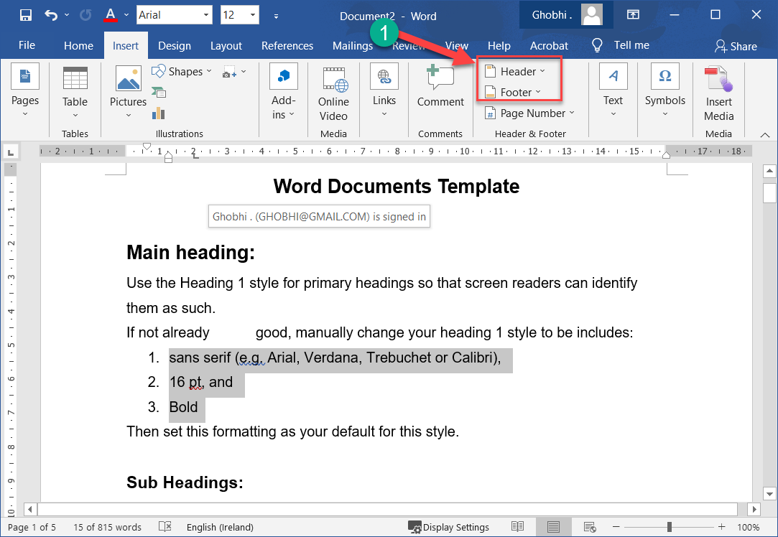
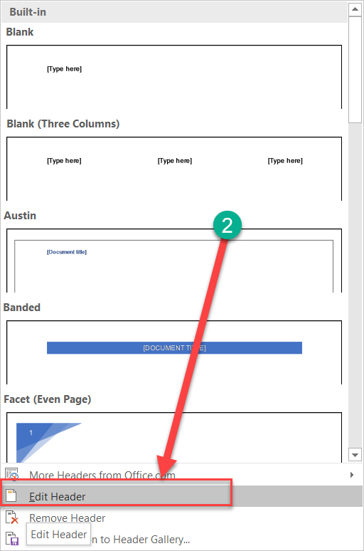
Create a Custom Header or Footer
Once you’ve added a header or footer, you can use the Header and Footer Design tab to customize its appearance.
添加页眉或页脚后，您可以使用页眉和页脚设计选项卡自定义其外观。

Slide 31
Create a Custom Header or Footer
Or, if you’d prefer to start from scratch, you can customize the header or footer without using one of the built-in presets.
或者，如果您更愿意从头开始，您可以自定义页眉或页脚，而无需使用任何内置预设

Slide 32
Create a Custom Header or Footer
Click the Header or Footer button on the Insert tab. |单击“插入”选项卡上的“页眉”或“页脚”按钮。
Select Edit Header or Edit Footer. | 选择编辑页眉或编辑页脚。

Slide 33
Create a Custom Header or Footer
The Header and Footer Design tab appears, and you can now add text, graphics, and placeholders to the header or footer.
页眉和页脚设计选项卡出现，您现在可以向页眉或页脚添加文本、图形和占位符。

Slide 34
Create a Custom Header or Footer
You can also display the Header and Footer Design tab and edit the header or footer by double-clicking in the top or bottom margins of the document, or by right-clicking in the top or bottom margins and selecting Edit Header or Edit Footer.
您还可以显示页眉和页脚设计选项卡并通过双击文档的顶部或底部边距，或通过右键单击顶部或底部边距并选择编辑页眉或编辑页脚来编辑页眉或页脚。

Slide 35
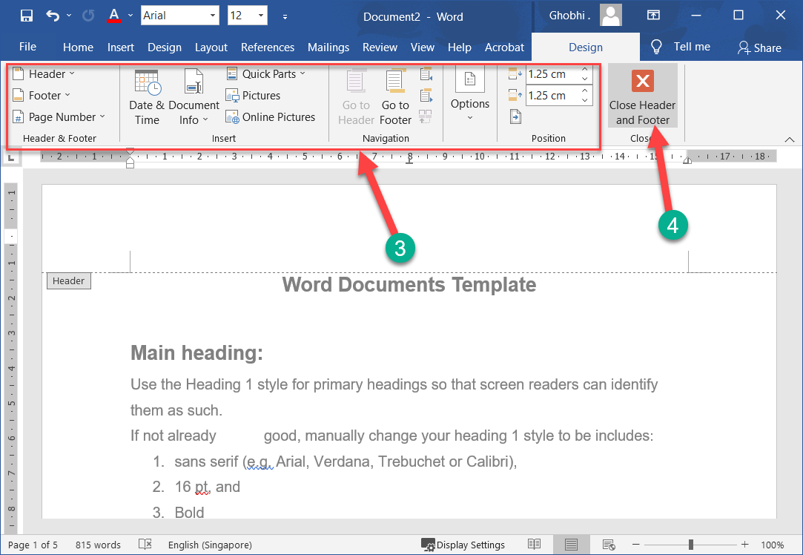
Create a Custom Header or Footer
Make selections using the Header and Footer Design tab tools on the ribbon. | 使用功能区上的页眉和页脚设计选项卡工具进行选择。

Slide 36
Create a Custom Header or Footer
The Insert group contains options for inserting document info placeholders, which are fields that automatically fill in information, such as page number, the current date, the file name and path, or the author’s name.
插入组包含用于插入文档信息占位符的选项，这些占位符是自动填写信息的字段，例如页码、当前日期、文件名和路径或作者姓名。

Slide 37
Create a Custom Header or Footer
In the Options group, you can also choose to use a different header or footer on the first page of a document, or to use different headers or footers on odd and even pages.
在选项组中，您还可以选择在文档的第一页上使用不同的页眉或页脚，或者在奇数页和偶数页上使用不同的页眉或页脚。

Slide 38
Create a Custom Header or Footer
Click Close Header and Footer when you’re done. |完成后单击关闭页眉和页脚。
The custom header or footer is applied.
应用自定义页眉或页脚。

Slide 39
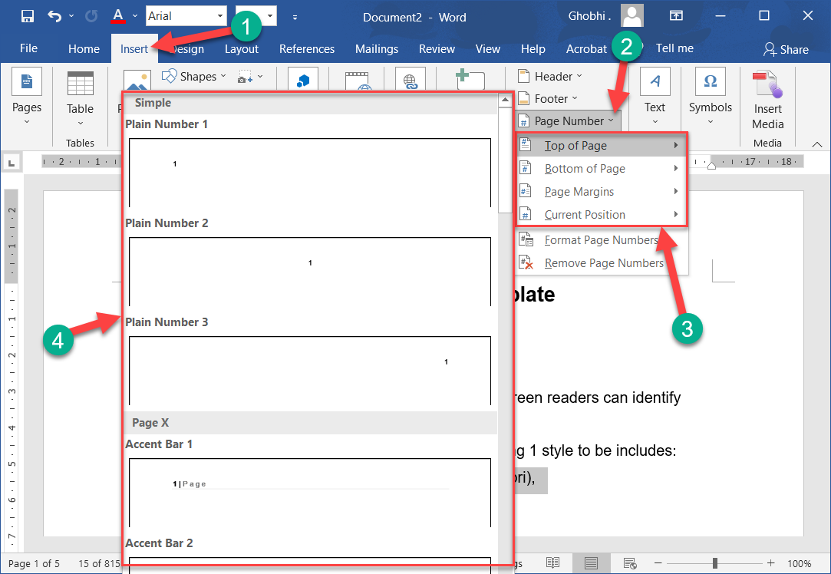
Page Numbers
If you have a longer document, you can add automatic page numbering to make it easier to know your place in the document.
如果您有较长的文档，您可以添加自动页码，以便更轻松地了解您在文档中的位置

Slide 40
Page Numbers
Click the Insert tab. |单击插入选项卡。
Click the Page Number button. |单击页码按钮。

Slide 41
Page Numbers
Next, choose where you want the page number to appear. You can choose either the header or footer, in the side margins, or where the text cursor is currently placed.
接下来，选择您希望页码出现的位置。您可以选择页眉或页脚、侧边距或当前放置文本光标的位置。

Slide 42
Page Numbers
Select a part of the page. There are plenty of built-in designs available, from plain numbers to more stylized numbers and shapes. | 选择页面的一部分。有大量可用的内置设计，从普通数字到更具风格化的数字和形状。

Slide 43
Page Numbers
Select a page number style. |选择页码样式。
The page number is added as a new page header or footer. The page number will increment automatically for each page, while the other text and decoration will stay the same.
页码作为新的页眉或页脚添加。每页的页码将自动增加，而其他文本和装饰将保持不变。

Slide 44
Page Numbers
Click the Close Header and Footer button. |单击关闭页眉和页脚按钮。
The page number is added.
页码已添加

Slide 45
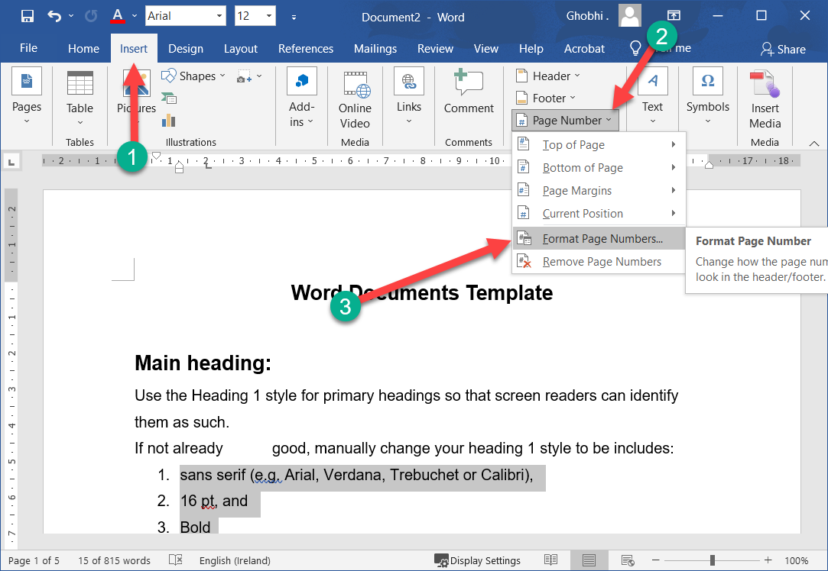
Format Page Numbers
Once you’ve added page numbers, you can customize the number format, enable chapter numbers, and adjust how the numbering starts.
添加页码后，您可以自定义编号格式、启用章节编号并调整编号的开始方式。

Slide 46
Format Page Numbers
Click the Insert tab. |单击插入选项卡。
Click the Page Number button. | 单击页码按钮。

Slide 47
Format Page Numbers
Select Format Page Numbers. |选择格式页码。
The Page Number Format dialog box opens, with a few ways to customize how page numbers appear.
“页码格式”对话框打开，提供了几种自定义页码显示方式的方法。

Slide 48
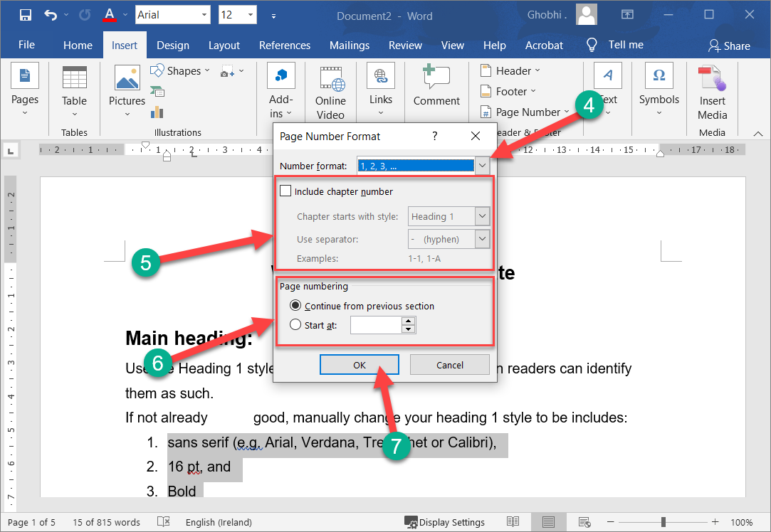
Format Page Numbers
Choose a number format. | 选择一种数字格式。
In addition to numbers, you could also use letters or roman numerals.
除了数字，您还可以使用字母或罗马数字。

Slide 49
Format Page Numbers
Include chapter numbers. |包括章节编号。
If your document is set up with chapter numbers, you can have those appear with the page numbers.
如果您的文档设置了章节编号，您可以让这些章节与页码一起出现。

Slide 50
Format Page Numbers
Modify page numbering. |修改页码。
If the document you’re working on is a continuation of another document, you can also specify a number that the page numbers will start at.
如果您正在处理的文档是另一个文档的延续，您还可以指定页码开始的编号。

Slide 51
Format Page Numbers
Click OK. |单击确定。
The number format has changed.
数字格式已更改。

Slide 52
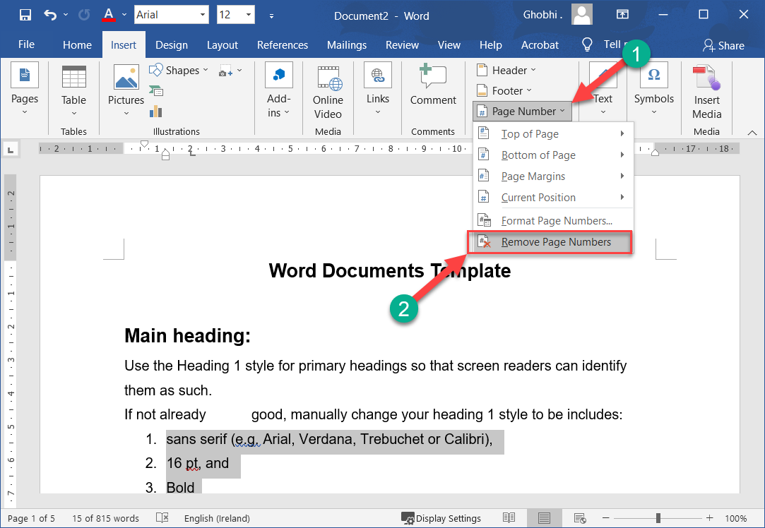
Remove Page Numbers
If your document no longer needs page numbers, they're easy to remove.
如果您的文档不再需要页码，它们很容易删除。
Click the Page Number button. | 单击页码按钮。

Slide 53
Remove Page Numbers
Select Remove Page Numbers. |选择删除页码。
The page numbers are removed. |页码被删除。
You can also remove page numbers manually by editing the header or footer to remove the page number placeholders.
您还可以通过编辑页眉或页脚来手动删除页码以删除页码占位符。

Slide 54
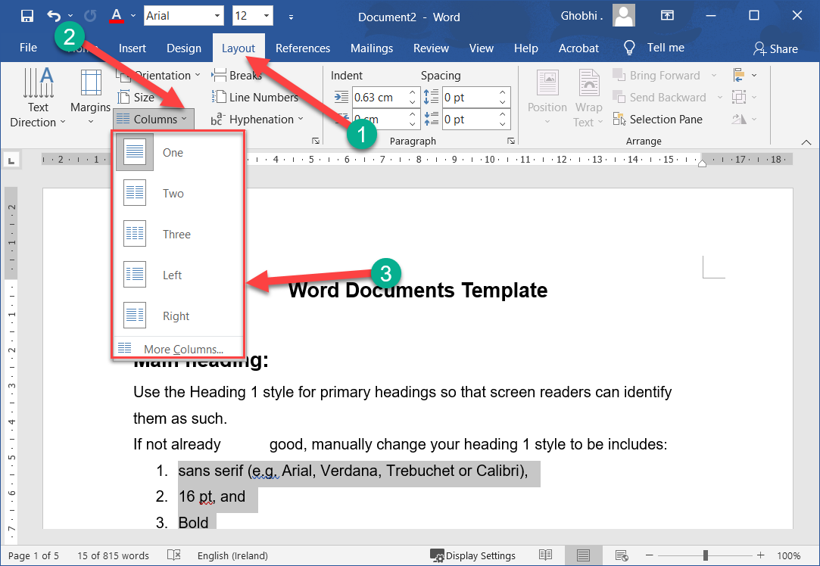
Columns
If you have a document that is pretty text-heavy, like a newsletter or magazine, you can format it in columns to make it a little easier to read. When using columns, you can also control where a new column begins using column breaks. 如果您有一个文本量很大的文档，例如时事通讯或杂志，您可以将其格式化为分栏以使其更易于阅读。使用列时，您还可以使用分栏符控制新列的开始位置

Slide 55
Format Columns
Click the Layout tab. |单击布局选项卡。
Click the Columns button. | 单击列按钮。

Slide 56
Format Columns
A short list of a few column options appears. You can select one, two, or three columns, or a special two-column layout with either the left or right column narrower than the other.
出现几个列选项的简短列表。您可以选择一列、两列或三列，或一种特殊的两列布局，其中左列或右列比另一列窄。

Slide 57
Format Columns
Select a column option. |选择一个列选项。
The column layout is applied.
应用列布局。
Select More Columns to manually configure your column layout from the Columns dialog box.
从“列”对话框中选择“更多列”以手动配置您的列布局。

Slide 58
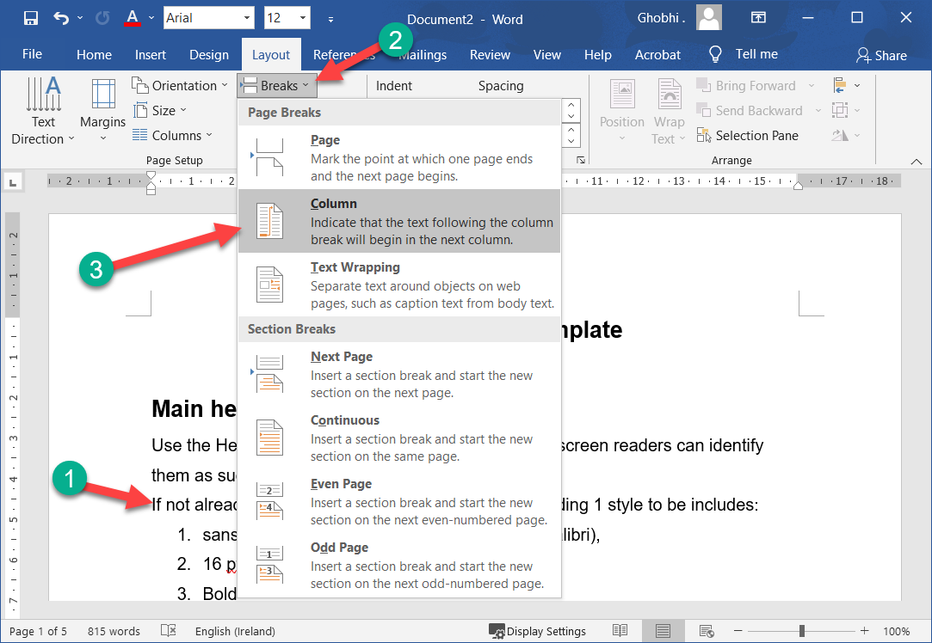
Use a Column Break
Inserting a column break ends the current column, moving the text cursor and any text after it to the top of the next column.
插入分栏符会结束当前列，将文本光标及其后的任何文本移动到下一列的顶部。

Slide 59
Use a Column Break
Click where you want to insert the column break. |单击要插入分栏符的位置。
Click the Breaks button on the Layout tab. | 单击布局选项卡上的中断按钮。

Slide 60
Use a Column Break
Select Column. |选择列。
The column break is inserted, and the cursor moves to the beginning of the next column.
插入分栏符，光标移动到下一列的开头。

Slide 61
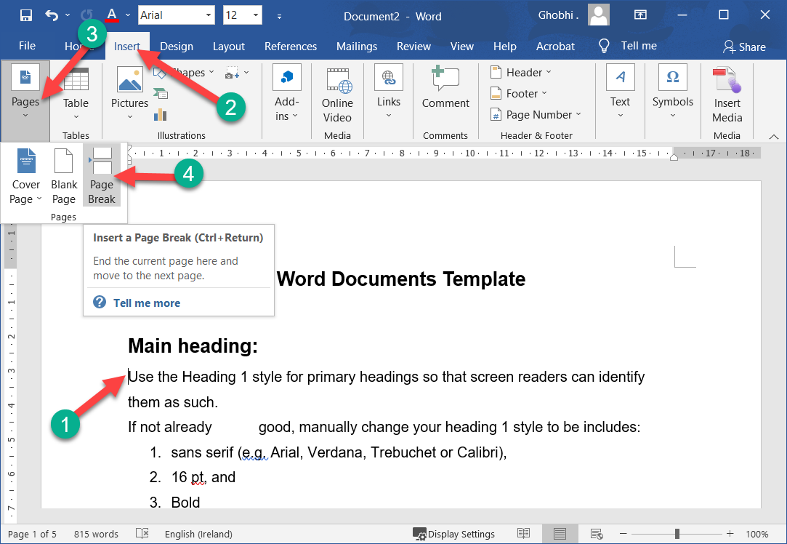
Page Break
While Word automatically manages when text flows to a new page in a document, you can also manually choose where a new page starts.
虽然 Word 会自动管理文本何时流向文档中的新页面，但您也可以手动选择新页面的开始位置

Slide 62
Insert Page Break
A page break is a special marker that will end the current page and start a new one.
分页符是一种特殊的标记，它将结束当前页面并开始一个新页面。
Click to place your cursor where you want to start a new page. | 单击以将光标置于要开始新页面的位置。

Slide 63
Insert Page Break
Click the Insert tab. |单击插入选项卡。
If necessary, expand the Pages group by clicking it. Click the Page Break button. | 如有必要，单击它展开页面组。单击分页符按钮。

Slide 64
Insert Page Break
A page break is inserted, and any text after that point is moved to a new page.
插入一个分页符，该点之后的任何文本都将移动到新页面。

Slide 65
Insert Page Break
Shortcut: You can also insert a page break by pressing Ctrl + Enter. Tip: If you’d rather insert an entire blank page at the break, select Blank Page in the Pages group.
快捷方式：您还可以通过按 Ctrl + Enter 插入分页符。提示：如果您希望在中断处插入整个空白页，请在页面组中选择空白页

Slide 66
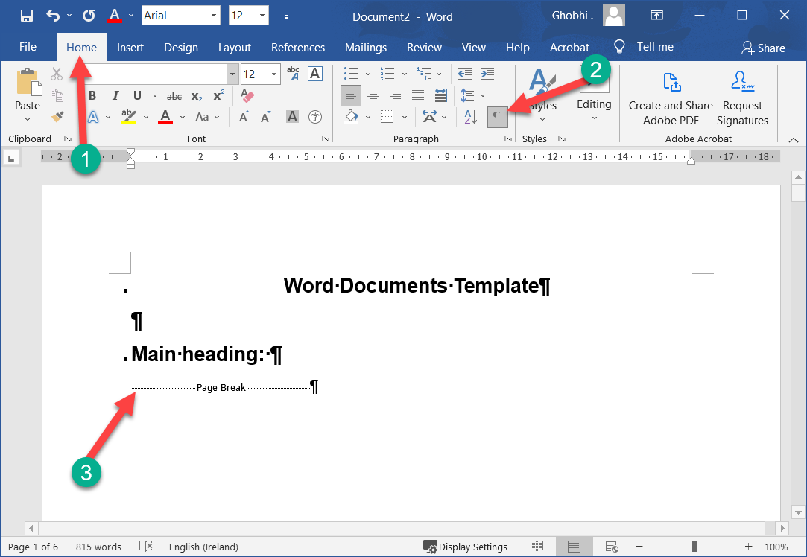
Remove Page Break
If you decide later that you don't want the page break where you inserted it, you can remove it.
如果您稍后决定不想在插入的位置使用分页符，则可以将其删除。

Slide 67
Remove Page Break
Page breaks are inserted as special hidden formatting marks, so to easily find and remove them, first show formatting marks.
分页符作为特殊的隐藏格式标记插入，因此要轻松查找和删除它们，请先显示格式标记。

Slide 68
Remove Page Break
Click the Home tab. |单击主页选项卡。
Click the Show/Hide ¶ button. | 单击显示/隐藏 ¶ 按钮。

Slide 69
Remove Page Break
This displays special punctuation characters in your document, such as spaces, paragraph markers, and most importantly for this lesson, page and section breaks.
这会在您的文档中显示特殊的标点符号，例如空格、段落标记，以及对于本课最重要的分页符和分节符。

Slide 70
Remove Page Break
Double-click the page break to select it. |双击分页符将其选中。
Press Delete. |按删除。
The page break is deleted.
分页符被删除。

Slide 71
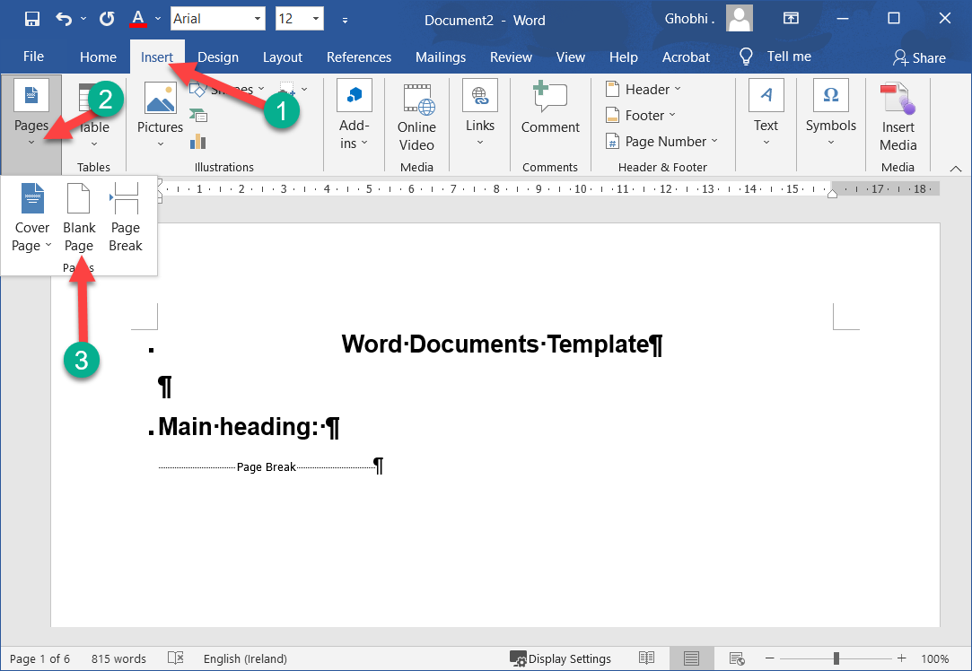
Insert a Blank Page
You can also insert an entire blank page at any point in the text.
您还可以在文本中的任何位置插入整个空白页。
With your insertion point where you want the blank page added, click the Insert tab. | 将插入点放在要添加空白页的位置，单击“插入”选项卡。

Slide 72
Insert a Blank Page
Expand the Pages group, if necessary. |如有必要，展开页面组。
Select Blank Page. |选择空白页。
Two page-breaks are inserted, creating a full blank page before the text continues.
插入两个分页符，在文本继续之前创建一个完整的空白页面。

Slide 73
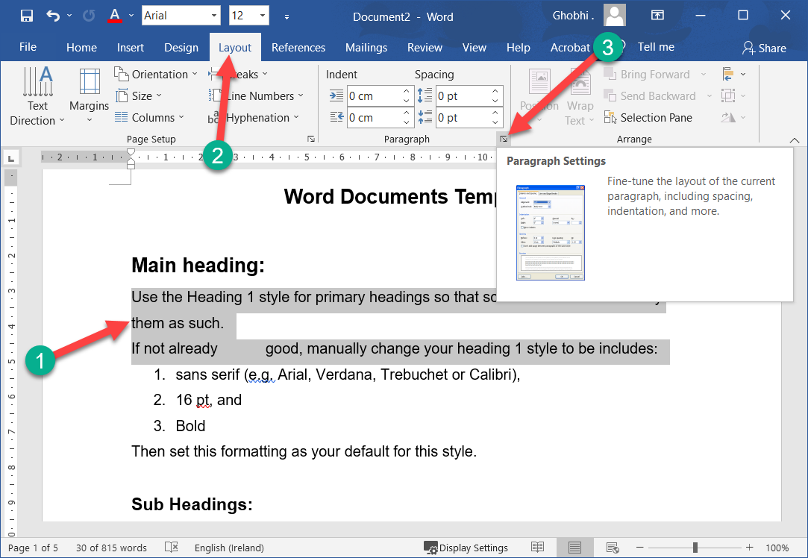
Paragraph Line & Page Break
You can also control breaks with paragraph formatting. For example, you can make sure an entire paragraph stays together on one page, or make sure a paragraph always starts on a new page.
您还可以使用段落格式控制中断。例如，您可以确保整个段落在一页上保持在一起，或者确保一个段落始终从新页面开始。

Slide 74
Paragraph Line & Page Break
Select the paragraph(s) that you want to format. |选择要设置格式的段落。
Click the Layout tab. |单击布局选项卡。
Click the Paragraph group’s dialog box launcher. | 单击段落组的对话框启动器。

Slide 75
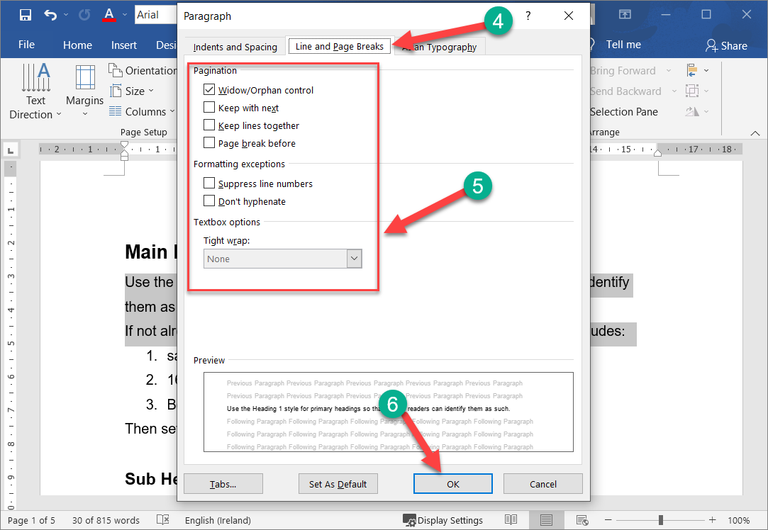
Paragraph Line & Page Break
Click the Line and Page Breaks tab. | 单击换行符和分页符选项卡。
Use the options to set your formatting. | 使用选项设置格式。
There are several options here that control how a paragraph will break across pages.
这里有几个选项可以控制一个段落如何跨页。

Slide 76
Paragraph Line & Page Break
Widow/Orphan control prevents the last line of a paragraph (widow), or the first line of a paragraph (orphan) from appearing by themselves on a page. An additional line will be moved up or down with the widow or orphan.
寡妇/孤儿控件防止段落的最后一行（寡妇）或段落的第一行（孤儿）自己出现在页面上。将与寡妇或孤儿一起向上或向下移动一条附加线。

Slide 77
Paragraph Line & Page Break
Keep with next will prevent the page from breaking between the selected paragraph and the following one.
Keep with next 将防止在所选段落和下一个段落之间分页。

Slide 78
Paragraph Line & Page Break
Keep lines together will prevent the page from breaking within the selected paragraph.
将行保持在一起将防止页面在所选段落内中断。
Page break before will add a page break before the selected paragraph.
Page break before 将在所选段落之前添加一个分页符。

Slide 79
Paragraph Line & Page Break
Click OK. |单击确定。
The line and page break options are applied to the selected paragraph(s).
换行和分页选项应用于选定的段落。

Slide 80
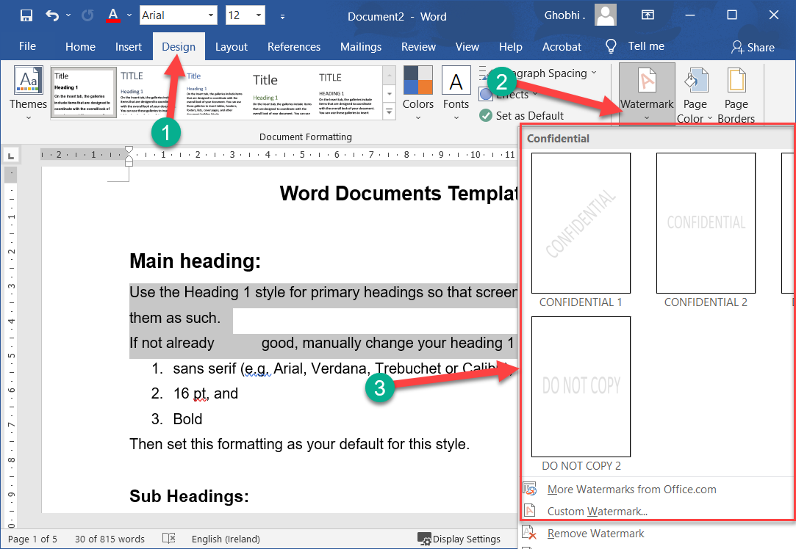
Page Background Elements
You can dress up pages in a document with page borders and background settings. You can line the margins of your pages with borders to give them finished edges or to make certain pages stand out, and you can even create your own page designs using colors and watermarks.

Slide 81
Page Background Elements
您可以使用页面边框和背景设置修饰文档中的页面。您可以将页面的边距与边框对齐，以赋予它们完成的边缘或使某些页面脱颖而出，您甚至可以使用颜色和水印创建自己的页面设计。

Slide 82
Watermark
A watermark is a faint message or image that indicates a document should be specially treated. It does not obscure text on the page.
水印是一种微弱的信息或图像，表明应该对文档进行特殊处理。它不会掩盖页面上的文本。

Slide 83
Watermark
Click the Design tab. |单击设计选项卡。
Click the Watermark button. |单击水印按钮。

Slide 84
Watermark
You can choose a built-in watermark from a category such as Confidential, Disclaimers, or Urgent, or you can create a custom watermark.
您可以从“机密”、“免责声明”或“紧急”等类别中选择内置水印，也可以创建自定义水印。

Slide 85
Watermark
Select a watermark. |选择水印。
It's applied to every page in the document, set behind the text.
它应用于文档中的每一页，设置在文本后面。

Slide 86
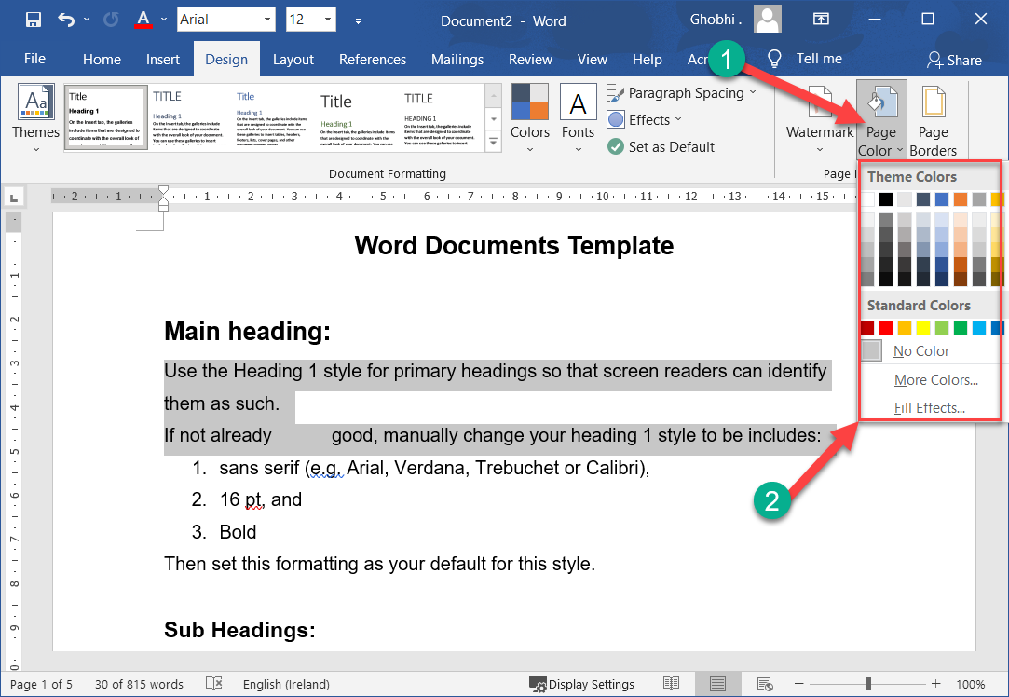
Page Colour
You can also add a background color to your document.
您还可以为文档添加背景颜色。
This color will only appear in digital copies of the document—Word will not print the page color.
这种颜色只会出现在文档的数字副本中——Word 不会打印页面颜色。

Slide 87
Page Colour
On the Design tab, click the Page Color button. |在“设计”选项卡上，单击“页面颜色”按钮。
Select a color. |选择一种颜色。

Slide 88
Page Colour
Page color won't be printed; it will only appear when viewed digitally—as a Word document, PDF, or web page.
不会打印页面颜色；它仅在以数字方式查看时才会显示为 Word 文档、PDF 或网页。

Slide 89
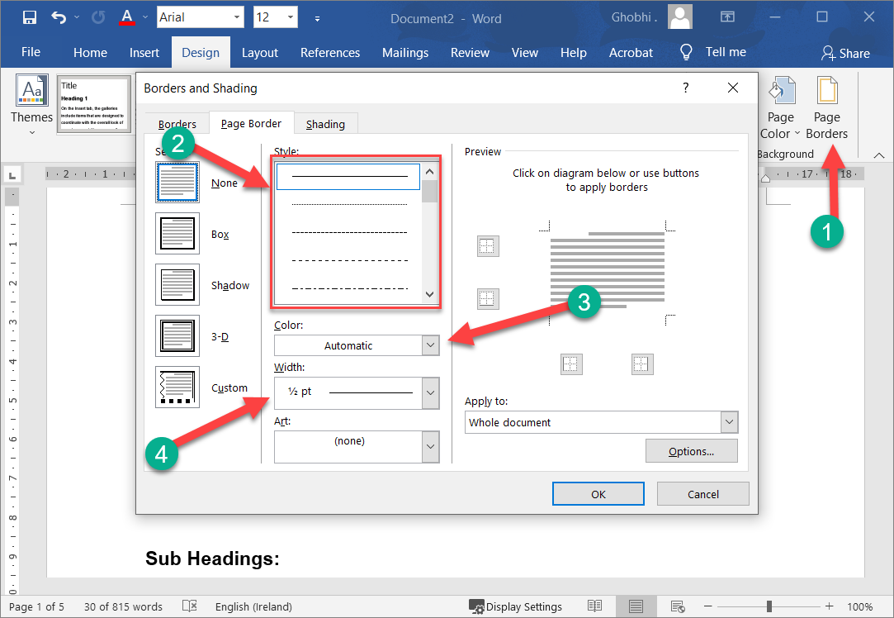
Page Border
Finally, you can add page borders along the margins to give it a finished look.
Pages.
最后，您可以沿页边距添加页面边框以使其具有完美的外观。
页

Slide 90
Page Border
On the Design tab, click the Page Borders button. | 在“设计”选项卡上，单击“页面边框”按钮。
Using the Borders and Shading dialog box, customize how you want the border to look.
使用“边框和底纹”对话框，自定义您希望边框的外观。

Slide 91
Page Border
Select a border style from the Style list. |从样式列表中选择边框样式。
You can choose from a variety of solid lines, dotted and dashed lines, and patterns. Select a border color.
您可以从各种实线、点划线和图案中进行选择。选择边框颜色。

Slide 92
Page Border
Select a border width. |选择边框宽度。
Choose which sides of the page will have a border by clicking the top, bottom, and/or sides of the preview. | 通过单击预览的顶部、底部和/或侧边，选择页面的哪些侧边将具有边框。

Slide 93
Page Border
Choose which sections of the document will have the border. |选择文档的哪些部分将具有边框。
You can choose the whole document, just this section, just the first page in this section, or every page in the section but the first page. | 您可以选择整个文档、仅此部分、仅此部分中的第一页或该部分中除第一页之外的每一页。

Slide 94
Page Border
Click OK. |单击确定。
The border is added to the selected pages
边框已添加到所选页面

Slide 95
Thank You!
Social Health Growth
200 Jalan Sultan #03-17, Textile Centre, Singapore 199018
Hotline: (65) 9751 6906, Fax: (65) 6338 2892
SHG is a registered Charity with Ministry of Social and Family Development
Website: www.socialhealthgrowth.org
Facebook: facebook.com/socialhealthgrowth.shg
Twitter: @SHG_Singapore
Instagram: socialhealthgrowth

