Slide 1
Computer & Mobile Literacy Program
Microsoft Word Basic – Part 3: Text & Paragraph Formatting

Slide 2

Learning Objectives
To understand how to format text and paragraphs
了解如何格式化文本和段落

Slide 3
Format Text & Paragraphs
Once you understand the basics of entering text, it’s time to move on to learning how to format that text in a way that looks nice and is very functional on the page.
一旦您了解了输入文本的基础知识，就可以继续学习如何以一种看起来不错且在页面上非常实用的方式来设置文本格式。
In this class, you’ll learn how to format text by changing font, size, color, and other effects. You’ll also learn ways to format paragraphs, including alignment, indenting, spacing, borders, and shading.
在本课程中，您将学习如何通过更改字体、大小、颜色和其他效果来设置文本格式。您还将学习设置段落格式的方法，包括对齐、缩进、间距、边框和阴影。

Slide 4
Format Text & Paragraphs
This class also shows how to format text and paragraphs as different types of lists, how to copy formatting, and how to find and replace formatting.
本课程还展示了如何将文本和段落格式化为不同类型的列表、如何复制格式以及如何查找和替换格式

Slide 5
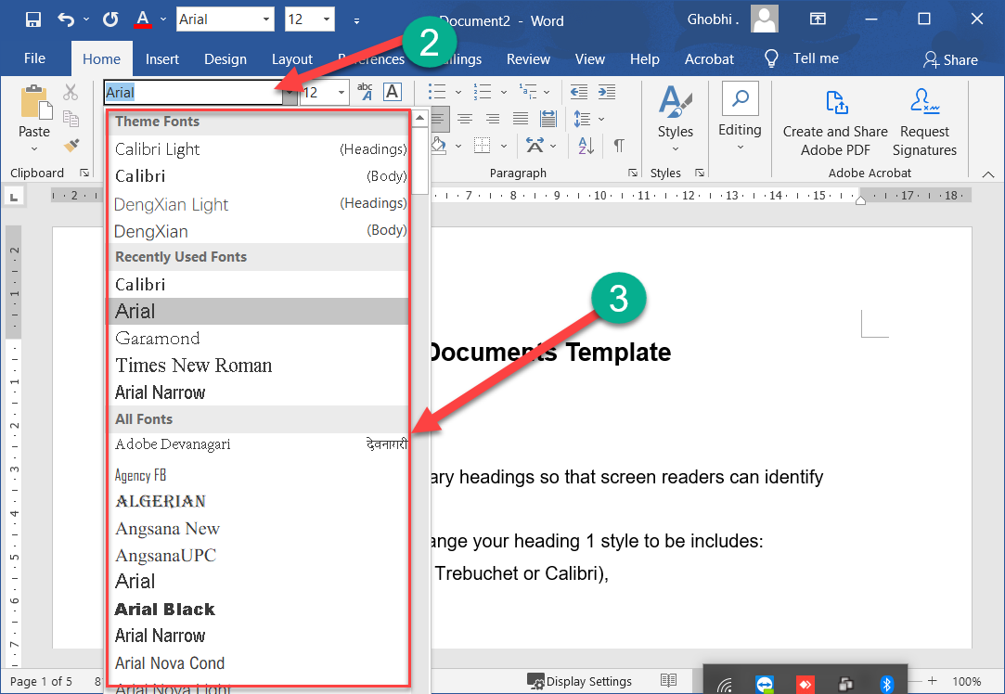
Change the Font
One way to change the appearance of text in a document is by changing its font type.
更改文档中文本外观的一种方法是更改​​其字体类型。

Slide 6
Change the Font
A font is a set of letters, numbers, and punctuation symbols designed around a shared appearance. A font will have variations for size and styles, such as bold and italics.
字体是围绕共享外观设计的一组字母、数字和标点符号。字体将具有大小和样式的变化，例如粗体和斜体

Slide 7
Change the Font
Changing a font itself will have the greatest effect on the appearance of text.
更改字体本身将对文本的外观产生最大的影响。
Select the text you want to change. | 选择要更改的文本。

Slide 8
Change the Font
Click the Font list arrow on the Home tab. |单击主页选项卡上的字体列表箭头。
You can also click the Font list arrow on the Mini Toolbar that appears when text is selected.
您还可以单击选择文本时出现的迷你工具栏上的字体列表箭头。

Slide 9
Change the Font
Select a new font from the list. |从列表中选择一种新字体。
The text is now sent in the selected font.
文本现在以所选字体发送。

Slide 10
Change the Font
When changing fonts, be sure to choose the right font for the tone of your document.
更改字体时，请确保为文档的色调选择正确的字体。
Don’t use casual script fonts in a professional document, and also avoid using too many fonts at once.
不要在专业文档中使用随意的脚本字体，也避免一次使用太多字体。

Slide 11
Font Types
Font Type | Examples | Description
Serif | Times New Roman, Garamond, Cambria, Georgia, Palatino | Serifs are small details at the ends of some letter strokes, meant to improve legibility. Suitable for both header and body text. 衬线是一些字母笔划末端的小细节，旨在提高可读性。适用于标题和正文文本
Sans Serif | Arial, Calibri, Helvetica, Verdana, Trebuchet MS | Sans serif fonts lack the small details at ends of letter strokes, leading to a plainer look. Suitable for both header and body text 无衬线字体缺少字母笔划末端的小细节，导致外观更简洁。适用于标题和正文文本

Slide 12
Font Types
Font Type | Examples | Description
Script | Brush Script, Zapfino, Lucida Handwriting | These fonts are meant to mimic handwriting, either calligraphic or casual. Useful in very specific designs, but unsuitable for body text and most headers. 这些字体旨在模仿手写体，无论是书法还是随意。在非常具体的设计中很有用，但不适用于正文和大多数标题。

Slide 13
Font Types
Font Type | Examples | Description
Monospace | Courier New, Consolas, American Typewriter | All letters and symbols use the exact same amount of space. Useful when displaying computer code, or when precise horizontal alignment between lines is important. 所有字母和符号使用完全相同的空间量。在显示计算机代码或行之间精确的水平对齐很重要时很有用。

Slide 14
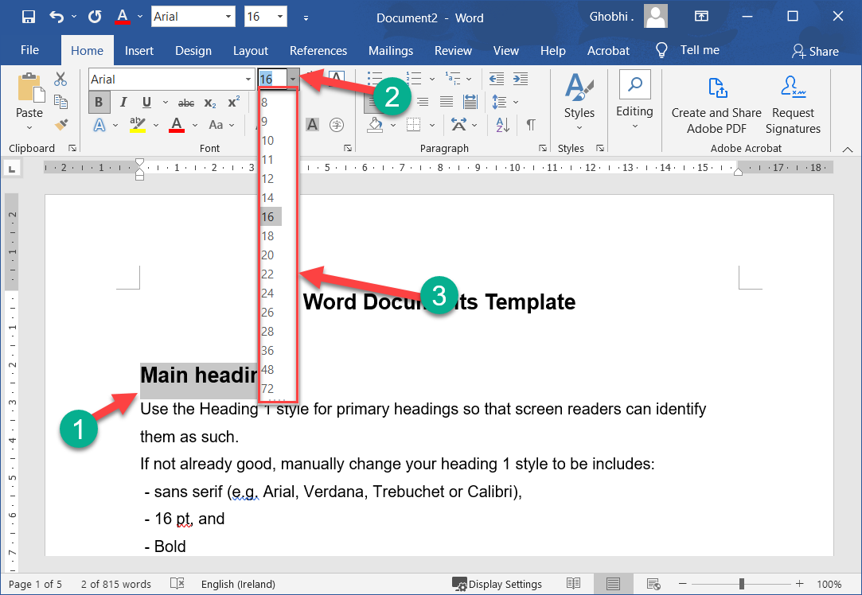
Change the Font Size
Changing the font size helps differentiate between titles, headers, and body text.
更改字体大小有助于区分标题、标题和正文文本
Select the text. | 选择文本。

Slide 15
Change the Font Size
Click the Font Size list arrow. |单击字体大小列表箭头。
You can also click the Font Size list arrow on the Mini Toolbar.
您还可以单击迷你工具栏上的字体大小列表箭头。

Slide 16
Change the Font Size
Select a font size. |选择字体大小
The font size changes.
字体大小发生变化。

Slide 17
Change the Font Size
Click the Increase Font Size or Decrease Font Size buttons to increase or decrease by one point at a time.
单击“增大字体大小”或“减小字体大小”按钮以一次增大或减小一点。

Slide 18
Change the Font Size
Note: Font size is measured in points (pt) that are 1/72 of an inch. The larger the number of points, the larger the font.
注意：字体大小以 1/72 英寸的磅 (pt) 为单位。点数越大，字体越大。

Slide 19
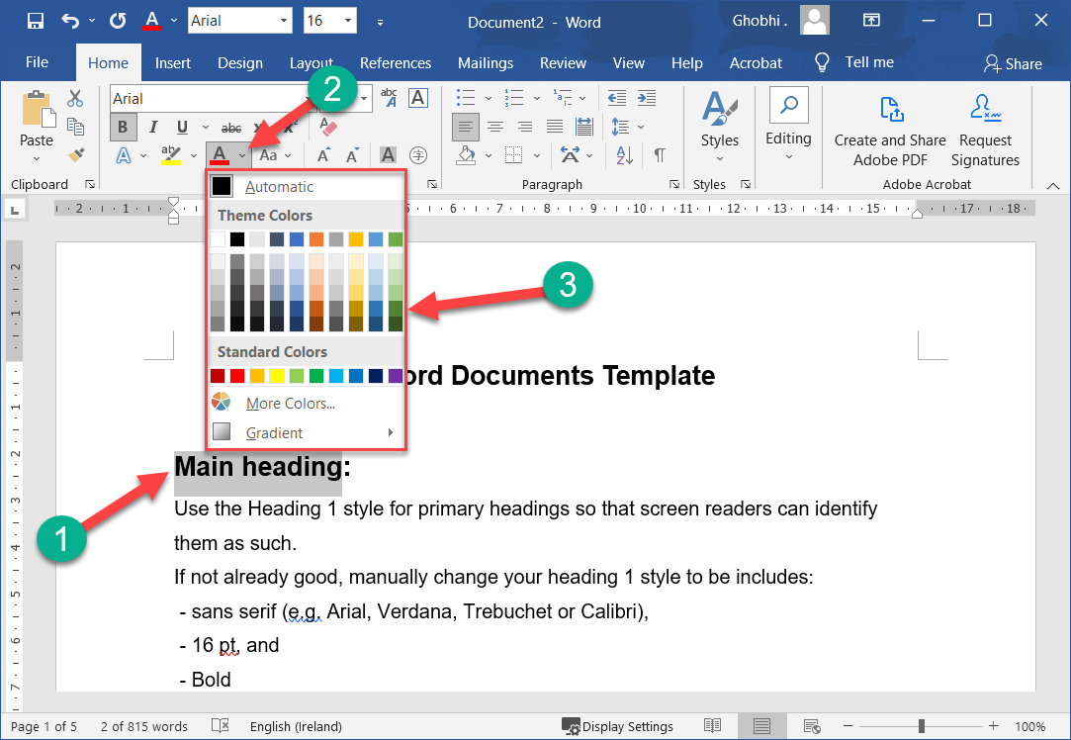
Change the Font Color
You may need to change font color to make text stand out, comply with brand standards, or add visual appeal.
您可能需要更改字体颜色以突出文本、符合品牌标准或增加视觉吸引力。
Select the text you want to change. | 选择要更改的文本。

Slide 20
Change the Font Color
Click the Font Color list arrow. |单击字体颜色列表箭头。
You can also click the Font Color list arrow on the Mini Toolbar.
您还可以单击迷你工具栏上的字体颜色列表箭头。

Slide 21
Change the Font Color
Select a new color. |选择一种新颜色。
If you don’t like any of the available theme colors, select More Colors to display the Colors dialog box.
如果您不喜欢任何可用的主题颜色，请选择更多颜色以显示颜色对话框。

Slide 22
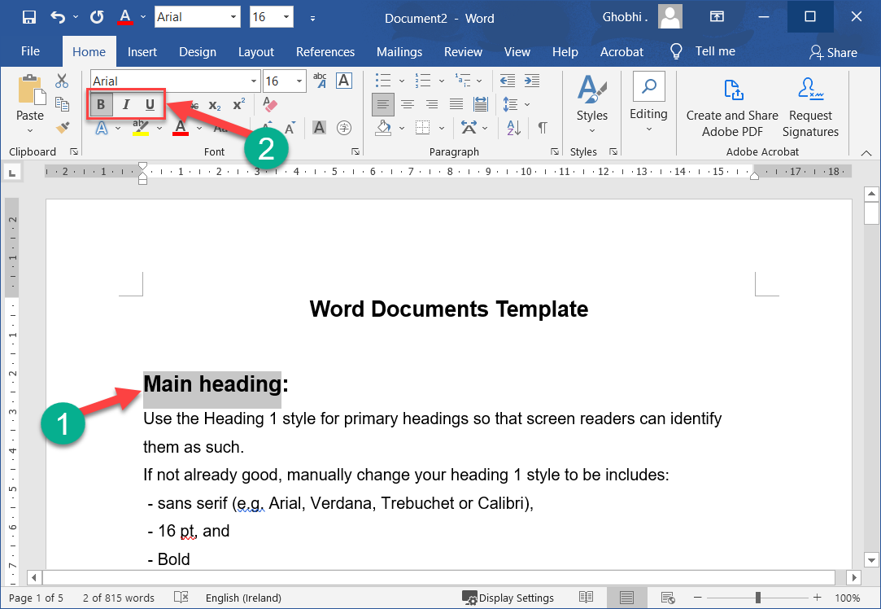
Apply Bold, Italic, Underline
In addition to changing font type, size, and color, you can also enhance the text further by using other features in the Font group like bold, italic, or underline.
除了更改字体类型、大小和颜色之外，您还可以使用字体组中的其他功能（如粗体、斜体或下划线）进一步增强文本。
Select the text you want to format. | 选择要格式化的文本。

Slide 23
Apply Bold, Italic, Underline
Select Bold, Italic, or Underline. |选择粗体、斜体或下划线。
Shortcuts:
To bold, Ctrl + B.
To italicize, Ctrl + I.
To underline, Ctrl + U.
快捷方式：
要加粗，请按 Ctrl + B。
要斜体，请按 Ctrl + I。
要下划线，请按 Ctrl + U
The effect is applied.
应用效果。

Slide 24
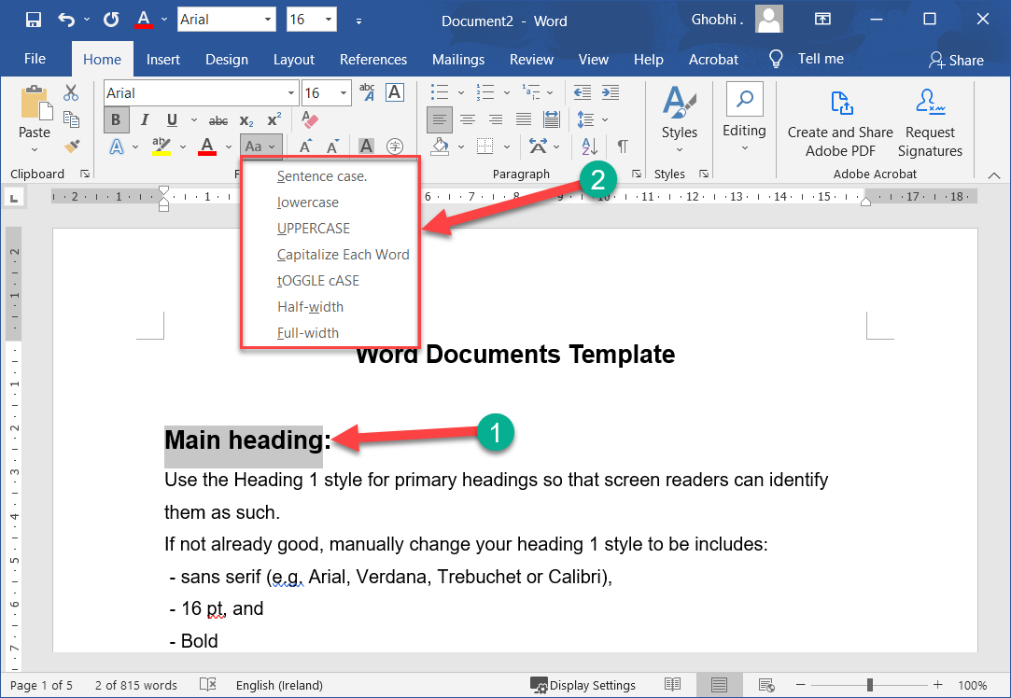
Change the Case
If you want to change the case of a block of text, you don’t need to retype the whole thing.
如果要更改文本块的大小写，则无需重新键入整个内容。
You can easily change the case of selected text with the Change Case menu.
您可以使用“更改案例”菜单轻松更改所选文本的大小写。

Slide 25
Change the Case
With the text selected, click Change Case. | 选择文本后，单击更改案例。

Slide 26
Change the Case
Select a case option. |选择一个案例选项。
You have several case options to choose from:
您有多种情况可供选择
Sentence case| 判例案
lowercase |小写
UPPERCASE |大写
Capitalize Each Word |每个单词大写
tOGGLE cASE |切换案例

Slide 27
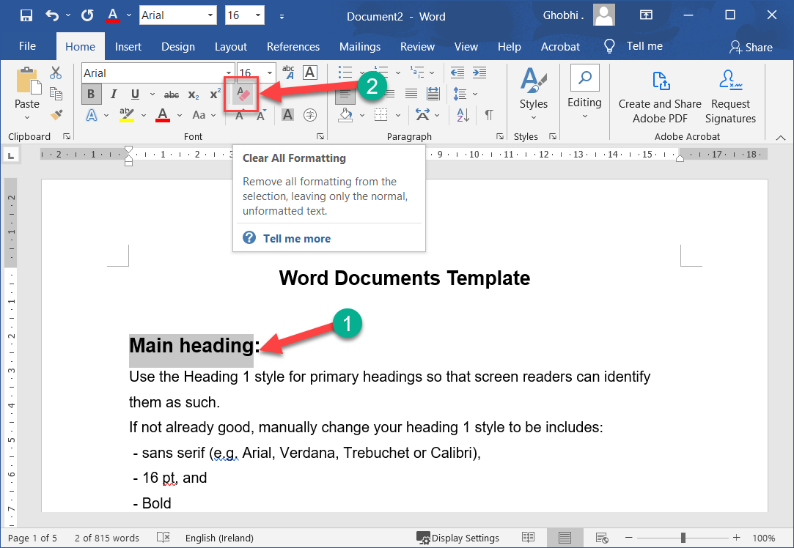
Clear Formatting
If you change your mind and want to remove all formatting from text, you can easily clear all formatting at once.
如果您改变主意并希望从文本中删除所有格式，您可以轻松地一次性清除所有格式。

Slide 28
Clear Formatting
With the text selected, click Clear All Formatting. |选择文本后，单击清除所有格式。
The extra formatting is removed, and the text is reset to the default style.
额外的格式被删除，文本被重置为默认样式。

Slide 29
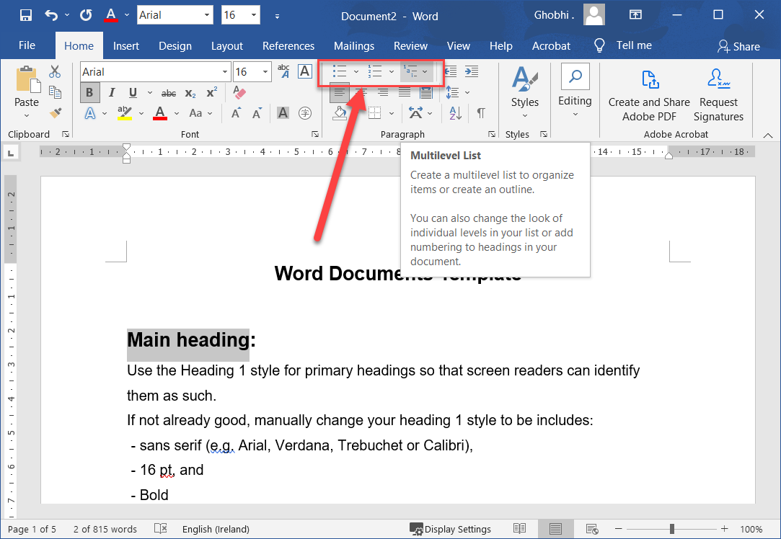
Create List
When you have a list of items to include in a document, you can format it as either a bulleted list or a numbered list.
当您有要包含在文档中的项目列表时，您可以将其格式化为项目符号列表或编号列表。

Slide 30
Create List
Adding a new item to a list will automatically insert a bullet, or a sequential number, in front of the item.
将新项目添加到列表将自动在项目前插入项目符号或序列号。

Slide 31
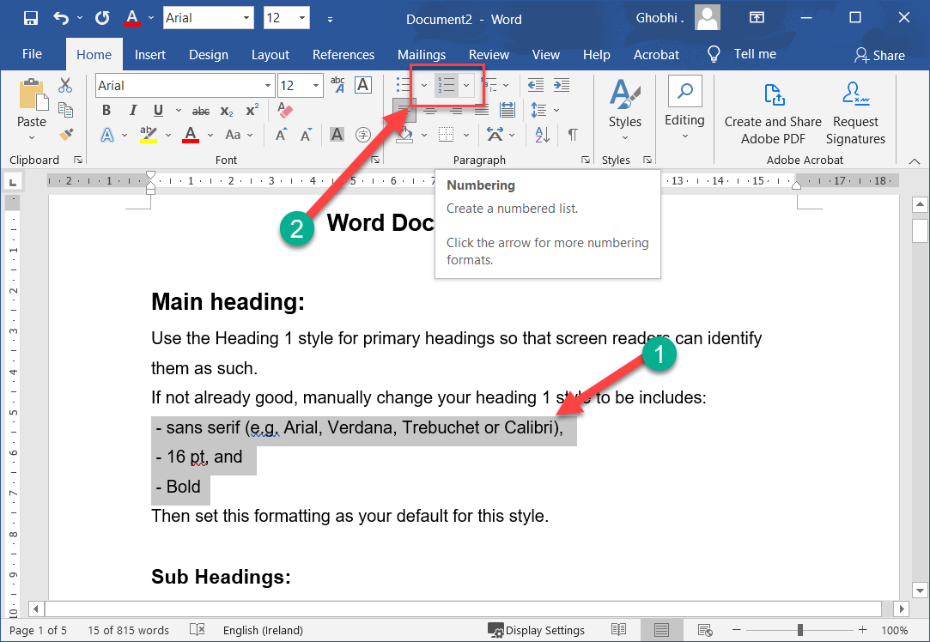
Numbered List
A numbered list will automatically number each line of the list in sequence.
编号列表将自动按顺序对列表的每一行进行编号。
This is helpful for a list of steps that must be done in order.
这对于必须按顺序完成的步骤列表很有帮助。

Slide 32
Numbered List
Select the text you want to use to make a numbered list. | 选择要用于制作编号列表的文本。

Slide 33
Numbered List
Click the Numbering button. | 单击编号按钮。
The selected items are turned into a numbered list. You can remove the list formatting by clicking the Numbering button again.
所选项目将变成一个编号列表。您可以通过再次单击编号按钮来删除列表格式。

Slide 34
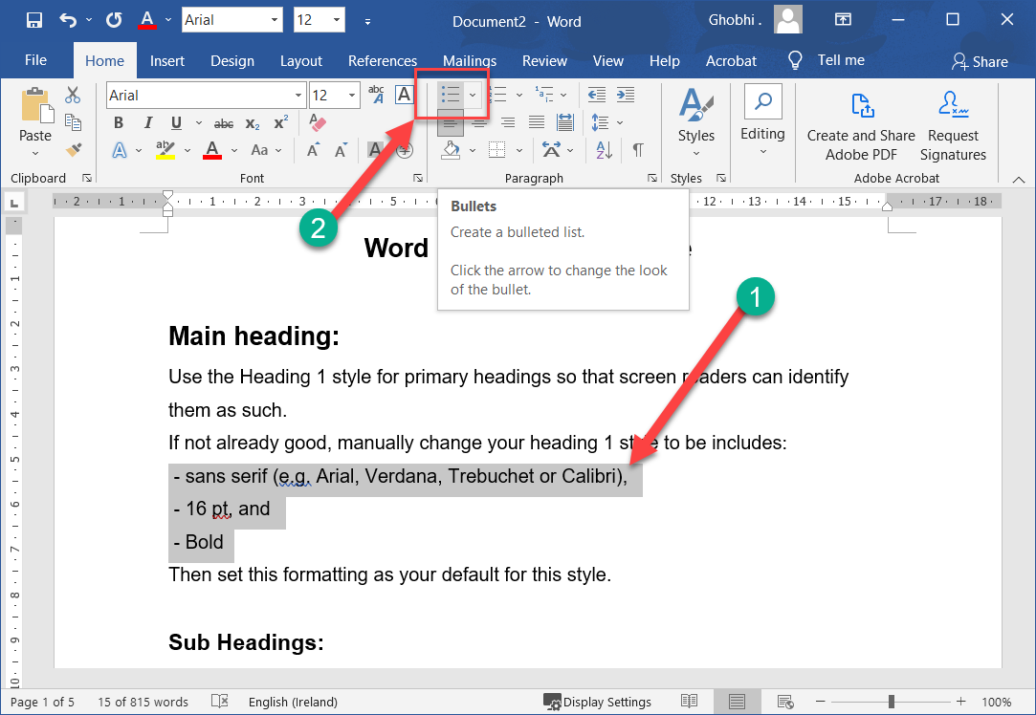
Bulleted List
Use bulleted lists when the order of items in a list doesn’t matter, such as listing items you need to buy.
当列表中项目的顺序无关紧要时使用项目符号列表，例如列出您需要购买的项目。

Slide 35
Bulleted List
Select the text you want to use to make a bulleted list. | 选择要用于制作项目符号列表的文本。

Slide 36
Bulleted List
Click the Bullets button. |单击项目符号按钮。
The selected items are formatted as a bulleted list.
所选项目的格式为项目符号列表。
Like with a numbered list, clicking the Bullets button again will turn off the list formatting
与编号列表一样，再次单击“项目符号”按钮将关闭列表格式

Slide 37
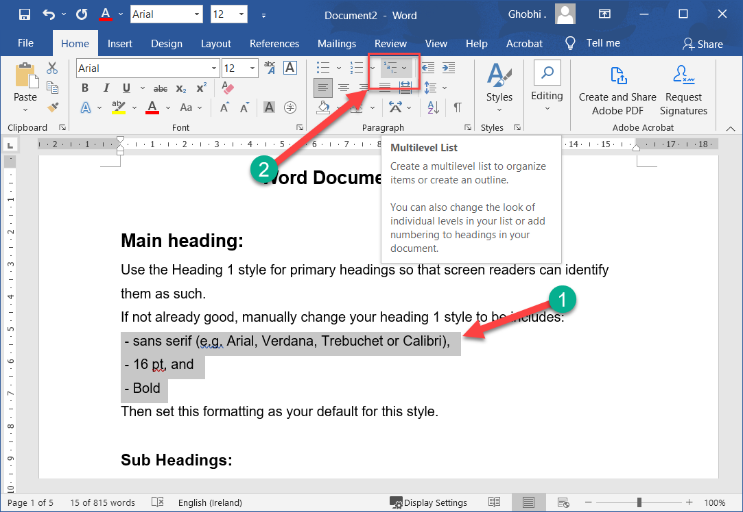
Multilevel Lists
Both numbered and bulleted lists can have multiple levels, letting you put together an outline of topics and subtopics.
编号列表和项目符号列表都可以有多个级别，让您可以将主题和副主题的大纲放在一起。
Any list can be turned into a multilevel list by demoting list items.
任何列表都可以通过降级列表项变成多级列表。

Slide 38
Multilevel Lists
Select the list item you want to demote. |选择要降级的列表项。
Click the Increase Indent button. |单击增加缩进按钮。
The list item is indented, and depending on the list style, the bullet or number may change.
列表项是缩进的，并且根据列表样式，项目符号或编号可能会发生变化。

Slide 39
Multilevel Lists
You can indent a list item multiple times to create additional levels. To promote a list item back to a higher level, just click the Decrease Indent button
您可以多次缩进列表项以创建附加级别。要将列表项提升回更高级别，只需单击减少缩进按钮

Slide 40
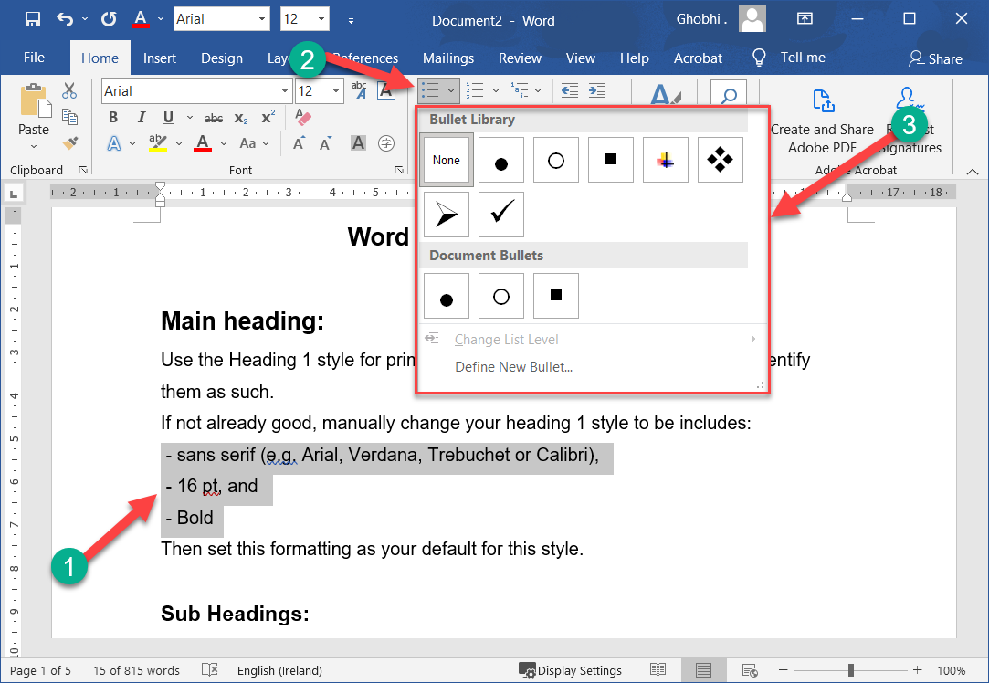
Change the List Style
While both bulleted and numbered lists have a default style, you can change the bullet style or numbering style for your lists.
虽然项目符号列表和编号列表都有默认样式，但您可以更改列表的项目符号样式或编号样式。

Slide 41
Change the List Style
Select the list you want to change. |选择要更改的列表。
You could also select just a single list item to change only that list item’s style.
您也可以只选择一个列表项来仅更改该列表项的样式。

Slide 42
Change the List Style
Click the Bullets button list arrow or the Numbering button list arrow. |单击项目符号按钮列表箭头或编号按钮列表箭头。

Slide 43
Change the List Style
Depending on which style of list you’re using, you can choose a new symbol for the bullets or a different numbering style, such as roman numerals.
根据您使用的列表样式，您可以为项目符号选择新符号或不同的编号样式，例如罗马数字。

Slide 44
Change the List Style
Select a new list style. | 选择新的列表样式。
The list style is updated.
列表样式已更新。

Slide 45
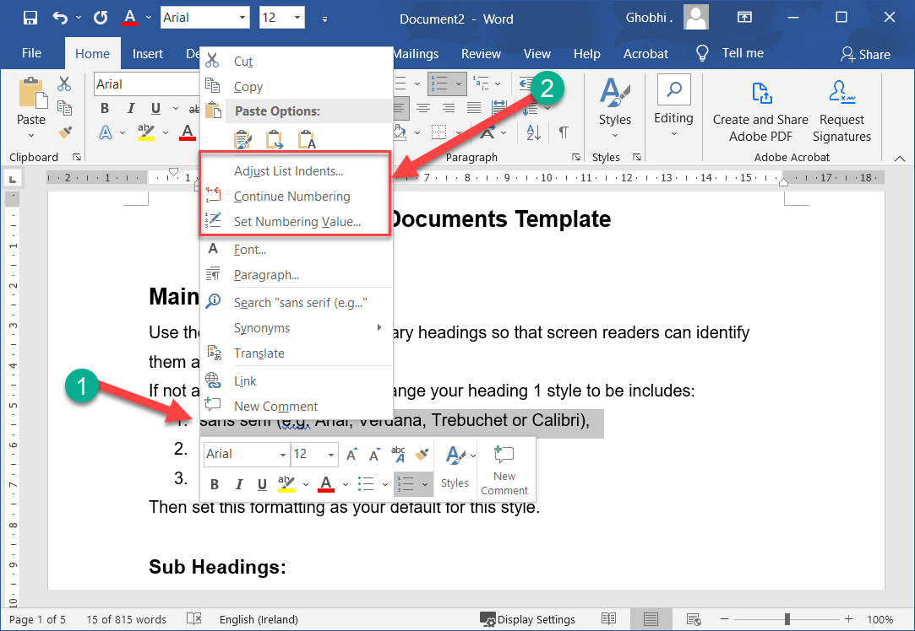
Custom Numbering
Numbered lists automatically number each list item in order, but you can change it if you need to.
编号列表会自动按顺序对每个列表项进行编号，但您可以根据需要对其进行更改。

Slide 46
Custom Numbering
Right-click a list number. |右键单击列表编号。
Select Set Numbering Value. |选择设置编号值。
Shortcut: To reset your list back to “1,” select Restart at 1 from the contextual menu.
快捷方式：要将列表重置回“1”，请从上下文菜单中选择“从 1 开始”。

Slide 47
Custom Numbering
Make your adjustments: |进行调整：
Start new list: This is the default, and it starts your list at “1.”
开始新列表：这是默认设置，它从“1”开始您的列表。

Slide 48
Custom Numbering
Continue from previous list: Start numbering where the numbered list prior to it left off. If you check Advance value, you can skip numbers.
从上一个列表继续：从之前的编号列表停止的位置开始编号。如果您选中高级值，则可以跳过数字。

Slide 49
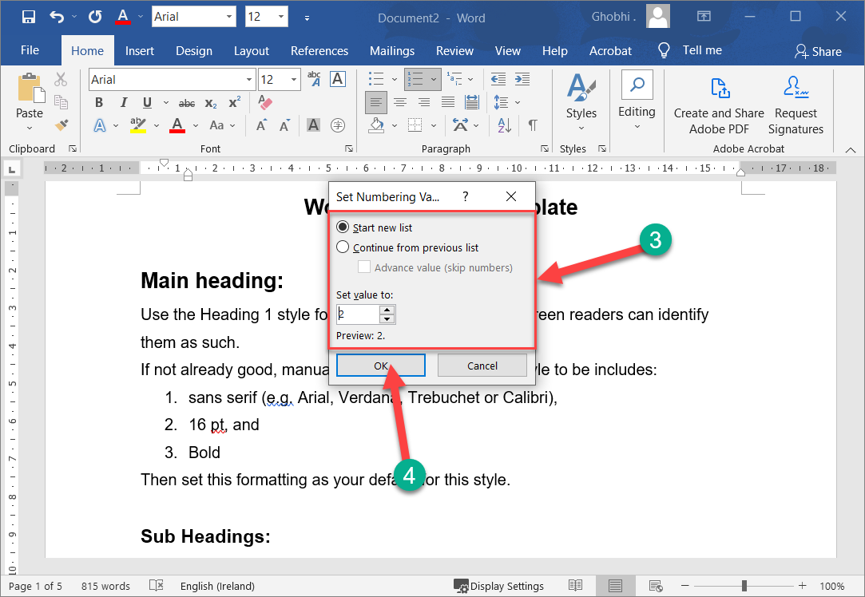
Create List: Custom Numbering
Make your adjustments: |进行调整：
Set value to: Allows you to manually enter a number other than “1” to start your list.
将值设置为：允许您手动输入“1”以外的数字以开始您的列表。

Slide 50
Custom Numbering
Click OK when you’re done. |完成后单击“确定”。
The list numbering is updated.
列表编号已更新。

Slide 51
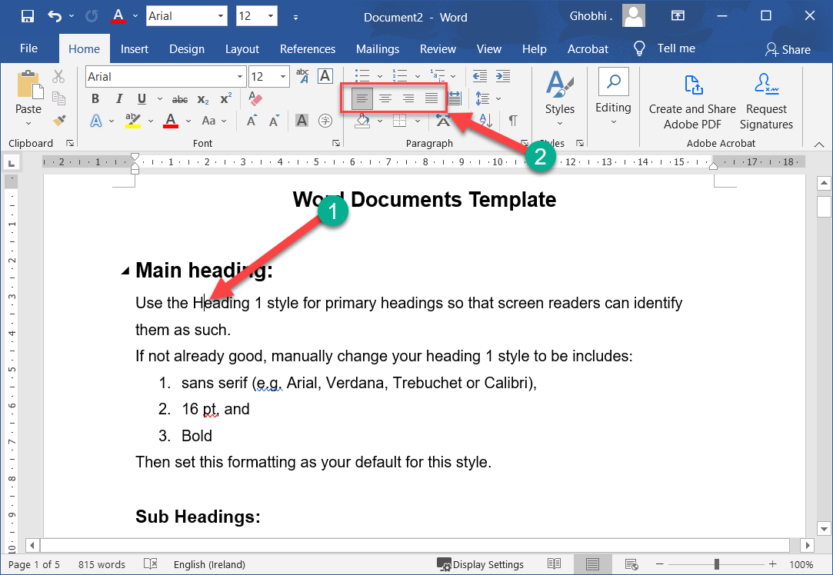
Paragraph Alignment
The text in your paragraphs is aligned to the left margin by default, but you can easily align it to the right margin, center it between the margins, or justify it to spread evenly between the margins on a page.
默认情况下，段落中的文本与左边距对齐，但您可以轻松地将其与右边距对齐、将其居中放置在页边距之间，或者调整它在页面上的页边距之间均匀分布。

Slide 52
Align a Paragraph
Click anywhere in a paragraph you want to align, or select multiple paragraphs. | 单击要对齐的段落中的任意位置，或选择多个段落。

Slide 53
Align a Paragraph
Click an alignment option in the Paragraph group. | 单击段落组中的对齐选项。
Shortcuts:
To align left, press Ctrl + L.
To align right, press Ctrl +R.
To center, press Ctrl + E.
To justify, press Ctrl + J
快捷方式：
要左对齐，请按 Ctrl + L。
要右对齐，请按 Ctrl + R。
要居中，请按 Ctrl + E。
要对齐，请按 Ctrl + J

Slide 54
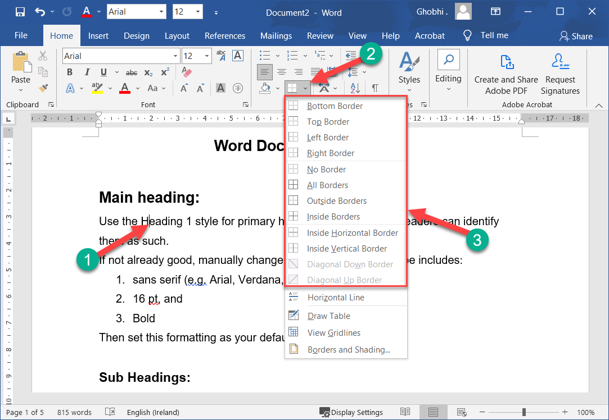
Borders & Shading
Adding borders and shading to paragraphs can make them more attractive, organized, and easy to read.
为段落添加边框和阴影可以使它们更具吸引力、更有条理且易于阅读。

Slide 55
Add a Border
Borders are lines that you can add to the top, bottom, left, or right of paragraphs.
边框是您可以添加到段落顶部、底部、左侧或右侧的线条。
They are especially useful for emphasizing headings.
它们对于强调标题特别有用。

Slide 56
Add a Border
Click in the paragraph where you want to add a border. |单击要添加边框的段落。
If you want to add the same kind of border to several paragraphs, select them all at once.
如果您想为多个段落添加相同类型的边框，请一次选择它们。

Slide 57
Add a Border
Click the Borders list arrow. | 单击边框列表箭头。

Slide 58
Add a Border
Select a border type. |选择边框类型。
The border is applied to the selected sides of the paragraph.
边框应用于段落的选定边。
To remove a border, select the No Border option in the Borders menu.
要删除边框，请在“边框”菜单中选择“无边框”选项

Slide 59
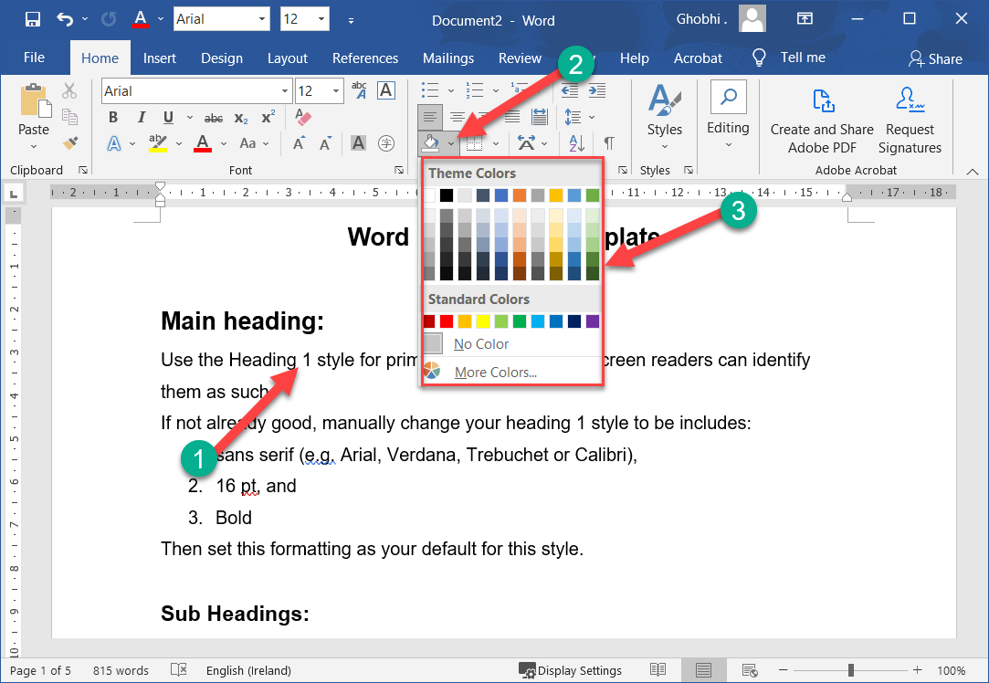
Add Shading
Change the background color of a paragraph by adding shading.
通过添加阴影来更改段落的背景颜色。

Slide 60
Add Shading
Select the paragraph or paragraphs you want to add shading to. | 选择要添加底纹的一个或多个段落。
Click the Shading list arrow. | 单击底纹列表箭头。

Slide 61
Add Shading
Select a shading color. |选择阴影颜色。
The color is applied behind the text.
颜色应用在文本后面。
If the color you want to use does not appear in the list, select More Colors to choose from a larger array of colors.
如果您要使用的颜色没有出现在列表中，请选择更多颜色以从更大的颜色阵列中进行选择。

Slide 62
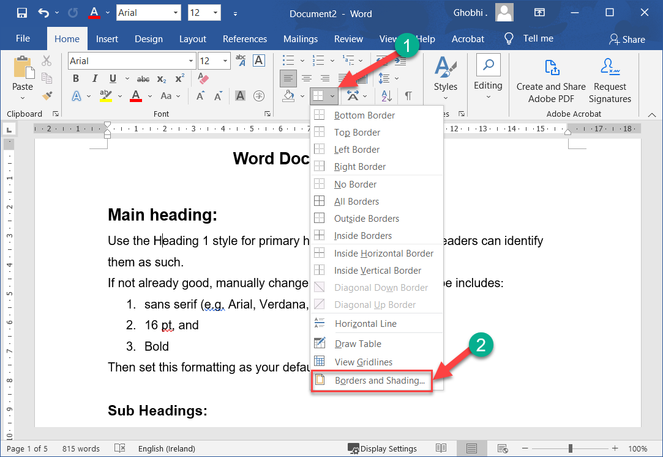
Add Border & Shading Options
If the options available on the ribbon don't have what you're looking for, open the Borders and Shading dialog box to see more options.
如果功能区上的可用选项没有您要查找的内容，请打开“边框和底纹”对话框以查看更多选项

Slide 63
Add Border & Shading Options
Click the Borders list arrow. |单击边框列表箭头。
Select Borders and Shading at the bottom of the menu. | 选择菜单底部的边框和底纹。

Slide 64
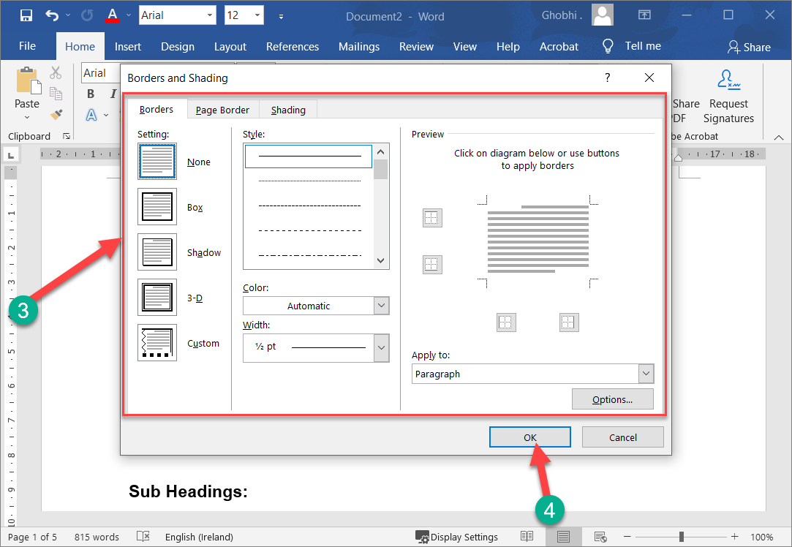
Add Border & Shading Options
Use the options in the dialog box to adjust the border and shading: |使用对话框中的选项来调整边框和阴影：

Slide 65
Add Border & Shading Options
To apply a border: Click the Borders tab and select your border style, color, and width. Then, click the side(s) of the paragraph in the Preview diagram where you want to apply the borders.
应用边框： 单击边框选项卡并选择边框样式、颜色和宽度。然后，单击预览图中要应用边框的段落的边。

Slide 66
Add Border & Shading Options
To apply shading: Click the Shading tab. Click the Fill list arrow and select the color you want to use. You can also click the Style list arrow in the Patterns group and select a pattern.
应用底纹： 单击底纹选项卡。单击填充列表箭头并选择要使用的颜色。您还可以单击样式组中的样式列表箭头并选择一个样式。

Slide 67
Add Border & Shading Options
Click OK when you’re done. |完成后单击“确定”。
The border and shading settings are applied.
应用边框和阴影设置。

Slide 68
Add Border & Shading Options
You can also add a border or shading to just some of the text rather than an entire paragraph.
您还可以为部分文本而不是整个段落添加边框或阴影。

Slide 69
Add Border & Shading Options
Select the text and open the Borders and Shading dialog box.
选择文本并打开边框和底纹对话框。
Click the Apply to list arrow, and select Text.
单击应用于列表箭头，然后选择文本。

Slide 70
Add Border & Shading Options
Then, specify the border and shading options you want to use.
然后，指定要使用的边框和阴影选项。

Slide 71
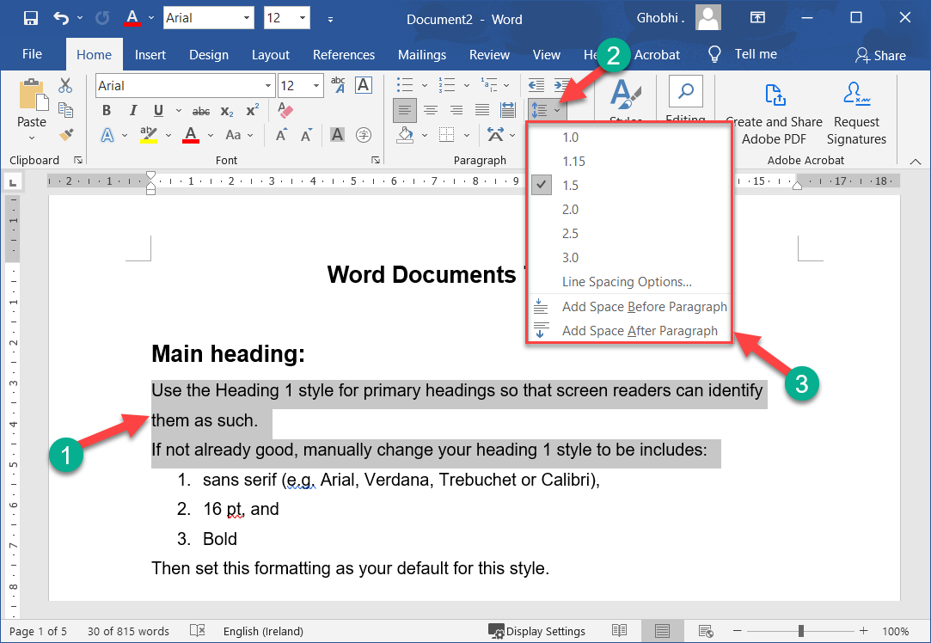
Line & Paragraph Spacing
You can change the amount of space between your lines and paragraphs to give documents structure and improve readability.
您可以更改行和段落之间的空间量，以赋予文档结构并提高可读性。

Slide 72
Change Line Spacing
Select the paragraph or paragraphs you want to adjust. | 选择要调整的一个或多个段落。

Slide 73
Change Line Spacing
Click the Line and Paragraph Spacing button. | 单击行和段落间距按钮。

Slide 74
Change Line Spacing
A list of line spacing options appears. The options here range from 1.0, which adds no extra space between lines, to 3.0, where the spacing for each line is triple that of a singlespaced line.
出现行间距选项列表。此处的选项范围从 1.0（不增加行之间的额外空间）到 3.0（其中每行的间距是单行行间距的三倍）。

Slide 75
Change Line Spacing
Select a spacing option. |选择间距选项。
The spacing between the selected lines is changed.
所选行之间的间距已更改。
For more spacing options, select Line Spacing Options to open the Paragraph group dialog box.
如需更多间距选项，请选择“行间距选项”以打开“段落”组对话框。

Slide 76
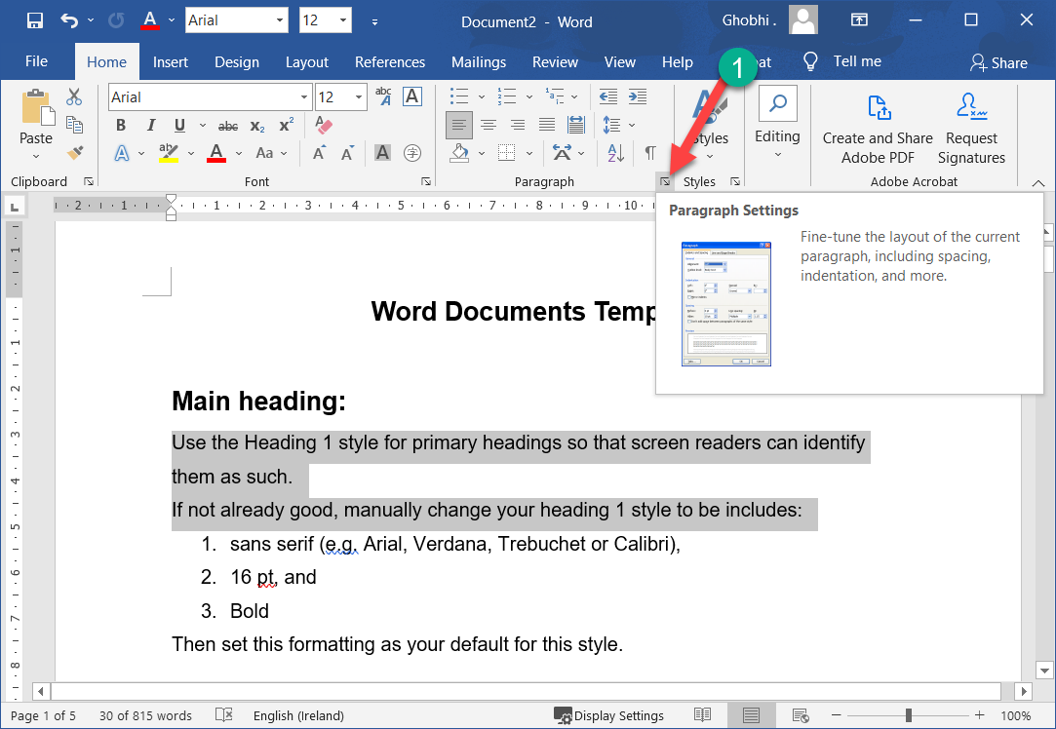
Change Paragraph Spacing
If you want to add space above or below the paragraph, adjust the paragraph spacing.
如果要在段落上方或下方添加空间，请调整段落间距。
Click the Paragraph dialog box launcher. | 单击段落对话框启动器。

Slide 77
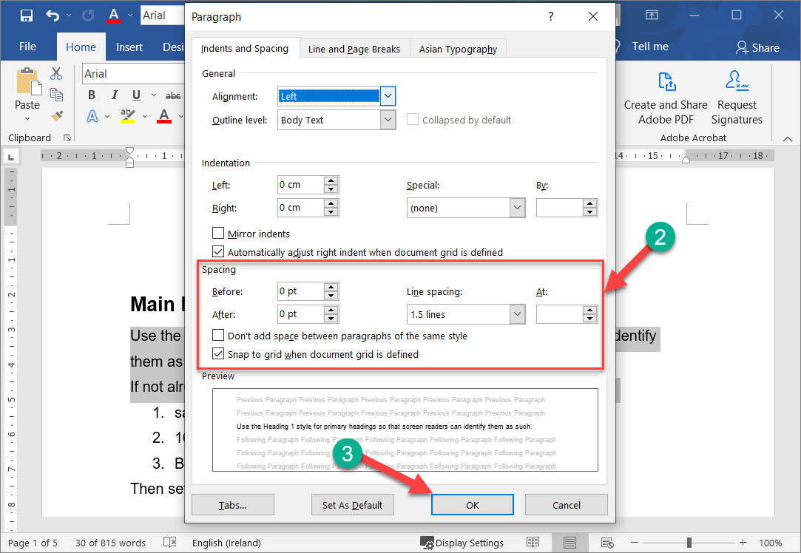
Change Paragraph Spacing
Adjust the settings in the Spacing group. |调整间距组中的设置。
Before: Adds space above the paragraph.
之前：在段落上方添加空格。
After: Adds space below the paragraph.
之后：在段落下方添加空格。

Slide 78
Change Paragraph Spacing
Click OK. | 单击确定。
Additional space will be added before or after the selected paragraph.
将在所选段落之前或之后添加额外的空间。

Slide 79
Change Paragraph Spacing
You can quickly add or remove 12 pts of spacing before or after the selected paragraph by clicking the Line and Paragraph Spacing button on the Home tab, then selecting Add/Remove Space Before Paragraph or Add/Remove Space After Paragraph.

Slide 80
Change Paragraph Spacing
通过单击主页选项卡上的行和段落间距按钮，然后选择在段落前添加/删除空格或在段落后添加/删除空格，您可以在所选段落之前或之后快速添加或删除 12 磅的间距。

Slide 81
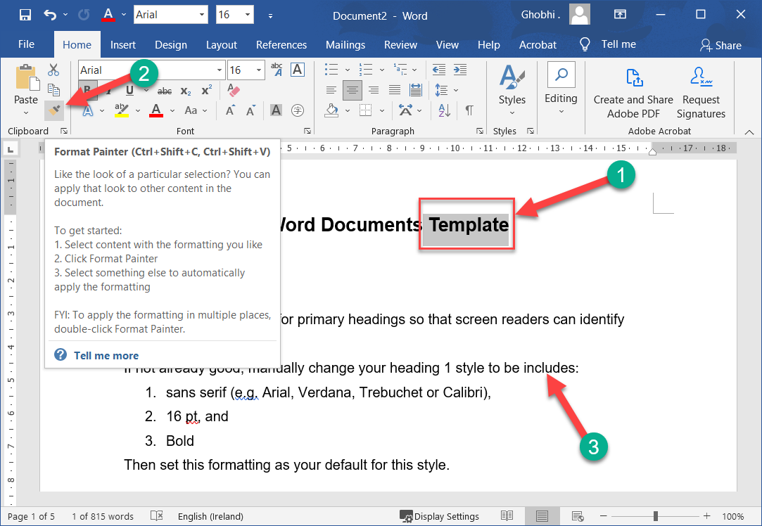
Copy Formatting
Once you get some text formatted just right, save yourself time applying the formats elsewhere by copying the formatting to other parts of the document.
一旦您将某些文本的格式设置得恰到好处，就可以通过将格式复制到文档的其他部分来节省在其他地方应用这些格式的时间。

Slide 82
Copy Formatting
The format painter copies the character formatting (like bolding, font color, or italics) and paragraph formatting (like line spacing or indentation) of the selected text so that you can quickly apply it somewhere else.
格式刷复制所选文本的字符格式（如加粗、字体颜色或斜体）和段落格式（如行距或缩进），以便您可以快速将其应用到其他地方。

Slide 83
Copy Formatting
Select the formatted text you want to copy. |选择要复制的格式化文本。
To copy paragraph formatting (such as line or paragraph spacing) as well as text formatting, select the entire paragraph you want to copy.
要复制段落格式（例如行距或段落间距）以及文本格式，请选择要复制的整个段落。

Slide 84
Copy Formatting
Click the Format Painter button on the Home tab. | 单击“主页”选项卡上的“格式刷”按钮。
The cursor changes to a paintbrush, indicating that the format painter is ready.
光标变为画笔，表示格式刷已准备就绪。

Slide 85
Copy Formatting
Select the text you want to apply the copied formatting to. | 选择要应用复制格式的文本。

Slide 86
Copy Formatting
To apply copied formatting to multiple areas, keep the format painter turned on by double-clicking the Format Painter button, and then select each area you want to apply the formatting to.
要将复制的格式应用到多个区域，请通过双击格式刷按钮保持格式刷打开，然后选择要应用格式的每个区域。

Slide 87
Copy Formatting
Click the Format Painter button again or press Esc to turn the Format Painter off when you’re done
完成后，再次单击“格式刷”按钮或按 Esc 关闭“格式刷”

Slide 88
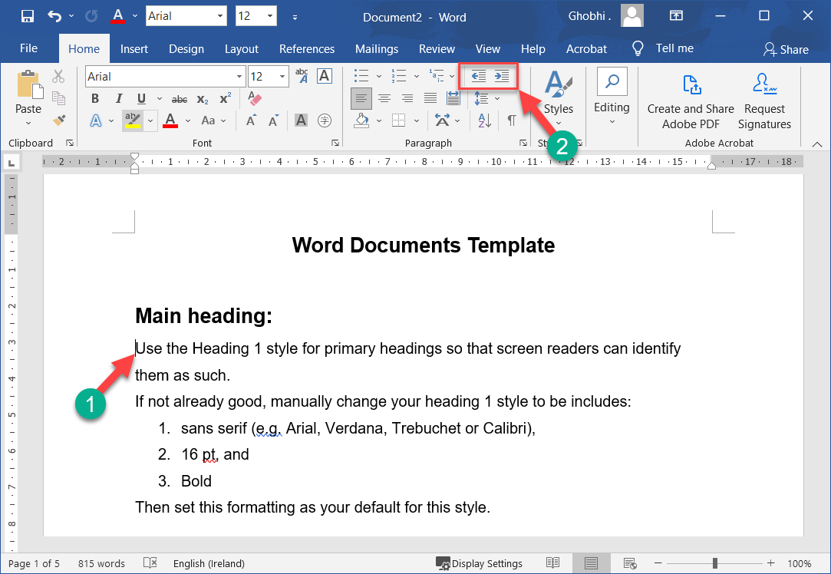
Indent Paragraphs
Indenting adds blank space between the page margin and the paragraph text. Long quotations, lists, and bibliographies are a few examples of paragraphs that are often indented.
缩进在页边距和段落文本之间添加空白。长引用、列表和参考书目是经常缩进的段落的几个例子。

Slide 89
Indent Paragraphs
The most common type of indent is a left indent, where text is indented in half-inch increments from the left margin.
最常见的缩进类型是左缩进，其中文本从左边距以半英寸为增量缩进。
You can quickly add or remove this type of indent from the Home tab.
您可以从“主页”选项卡快速添加或删除这种类型的缩进。

Slide 90
Indent Paragraphs
Click anywhere in the paragraph you want to change indentation. | 单击段落中要更改缩进的任意位置。

Slide 91
Indent Paragraphs
Click the Increase Indent or Decrease Indent button on the Home tab. |单击主页选项卡上的增加缩进或减少缩进按钮。
The paragraph’s indent from the left margin is increased or decreased by 0.5” increments each time the button is clicked.
每次单击按钮时，段落从左边距的缩进都会增加或减少 0.5 英寸的增量。

Slide 92
Custom Indentation Options
You can easily set a custom indent, specifying the exact amount of space between the text and margins on both the left and right sides.
您可以轻松设置自定义缩进，指定文本和左右两侧边距之间的确切空间量

Slide 93
Custom Indentation Options
Click the Paragraph dialog box launcher. | 单击段落对话框启动器。

Slide 94
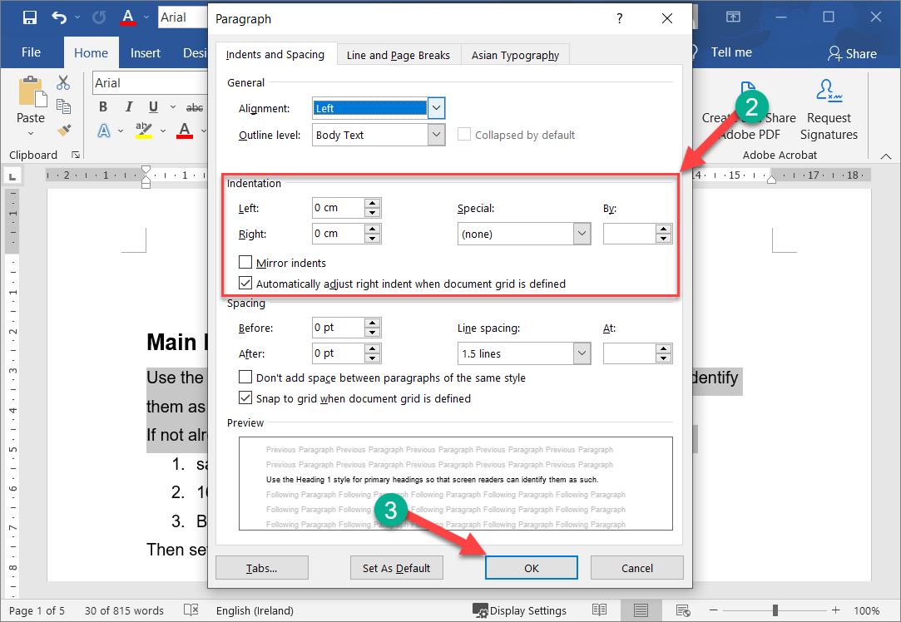
Custom Indentation Options
Adjust the indentation settings. |调整缩进设置。
You can adjust the indentation on both the left and right sides of the paragraph.
您可以调整段落左侧和右侧的缩进。

Slide 95
Custom Indentation Options
Click OK when you’re done to close the dialog box. | 完成后单击“确定”关闭对话框。

Slide 96

Custom Indentation Options
Click and drag the Left Indent marker or the Right Indent marker on the Ruler to adjust where the text will start and end on a line.
单击并拖动标尺上的左缩进标记或右缩进标记以调整文本在一行上的开始和结束位置。

Slide 97
First Line & Hanging Indents
Besides the left and right indents, two special indents can be used in your paragraphs: hanging and first line indents.
除了左右缩进，您的段落中还可以使用两种特殊的缩进：悬挂缩进和首行缩进。

Slide 98
First Line & Hanging Indents
A first line indentation lets you indent the first line of a paragraph independently of the other lines. In hanging indentation, the first line of the paragraph remains against the left margin while the other lines in the paragraph are indented.
首行缩进允许您独立于其他行缩进段落的第一行。在悬挂缩进中，段落的第一行保持在左边距，而段落中的其他行则缩进。

Slide 99
First Line & Hanging Indents
Hanging indentations are often used in bibliographies or lists
悬挂缩进常用于参考书目或列表

Slide 100
First Line & Hanging Indents
Hanging indentations are often used in bibliographies or lists
悬挂缩进常用于参考书目或列表

Slide 101
First Line & Hanging Indents
Click the Paragraph dialog box launcher. | 单击段落对话框启动器。

Slide 102
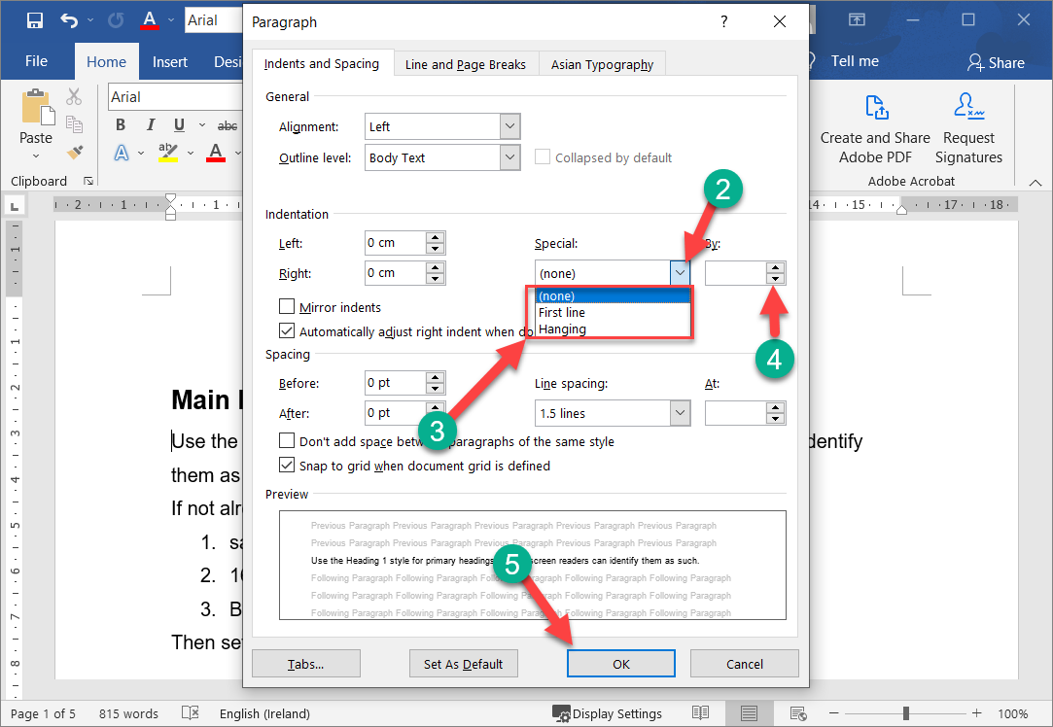
First Line & Hanging Indents
Click the Special list arrow. |单击特殊列表箭头。
Select an option: | 选择一个选项：
First line: Indents the first line of a paragraph independently of the other lines.
第一行：独立于其他行缩进段落的第一行。

Slide 103
First Line & Hanging Indents
Hanging: The first line of a paragraph will remain against the left margin, while the other lines in the paragraph are indented.
悬挂：段落的第一行将保持在左边距，而段落中的其他行则缩进。
Enter the indent amount or use the arrows to increase or decrease the indent. | 输入缩进量或使用箭头增加或减少缩进。

Slide 104
First Line & Hanging Indents
Click OK when you’re done. | 完成后单击“确定”。
The selected paragraph will be set with the special indent.
所选段落将设置特殊缩进。

Slide 105
First Line & Hanging Indents
Click and drag the First Line Indent marker on the ruler to adjust the first line indent or drag the Hanging Indent marker to adjust that indent.
单击并拖动标尺上的首行缩进标记以调整首行缩进或拖动悬挂缩进标记以调整该缩进。

Slide 106
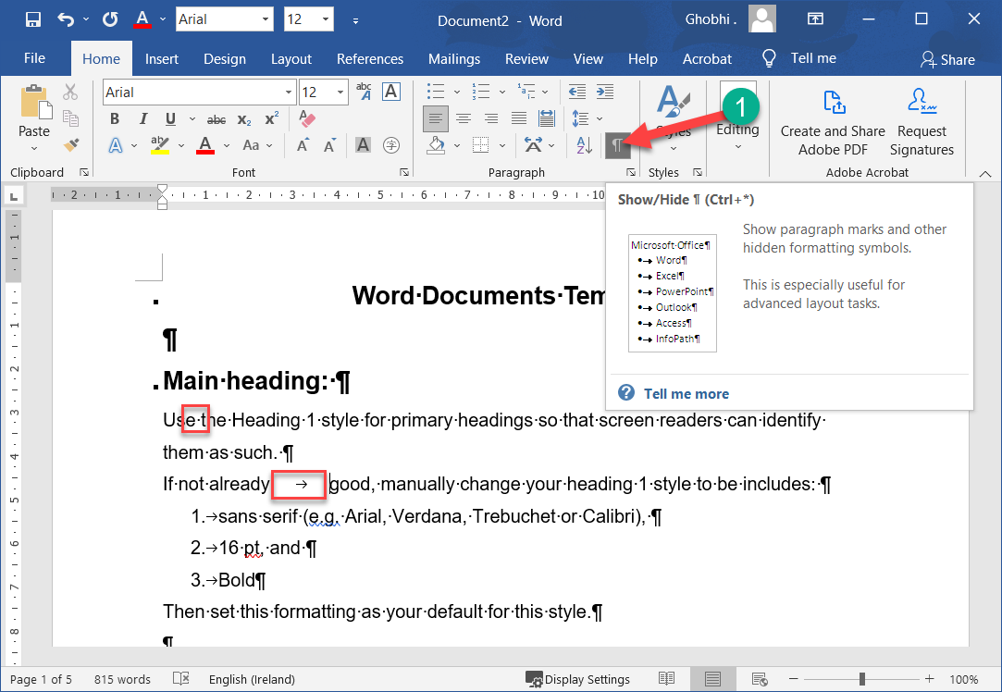
Tab Stops
By using tab stops in your document, you can create uniformly spaced text. And, unlike if you were to just enter a bunch of spaces to separate text, tabs ensure your text remains properly aligned.
通过在文档中使用制表位，您可以创建等距文本。而且，与您只需输入一堆空格来分隔文本不同，制表符可确保您的文本保持正确对齐。

Slide 107
Tab Stops
Each time you press the Tab key, the cursor moves to the next tab stop. By default, Word has left tab stops set at every half-inch, but you can create your own tab stops in a specific position or change the location of the existing tab stops. 每次按 Tab 键时，光标都会移动到下一个制表位。默认情况下，Word 将制表位设置为每半英寸，但您可以在特定位置创建自己的制表位或更改现有制表位的位置

Slide 108
Enable Formatting Marks & Ruler
Before you start adjusting tab stops, make sure to turn on both formatting marks and the ruler.
在开始调整制表位之前，请确保打开格式标记和标尺。

Slide 109
Enable Formatting Marks & Ruler
The formatting marks make it easy to see what's going on in your document, especially when it comes to tabs. The ruler is necessary to easily add, move, and remove tab stops.
格式标记使您可以轻松查看文档中的内容，尤其是在涉及选项卡时。要轻松添加、移动和删除制表位，必须使用标尺。

Slide 110
Enable Formatting Marks & Ruler
Click the Show/Hide ¶ button on the Home tab. | 单击主页选项卡上的显示/隐藏 ¶ 按钮。
Each space is represented by a dot (⋅), each pilcrow (¶) is a new paragraph, and each arrow (→) is a tab.
每个空格由一个点 (⋅) 表示，每个 pilcrow (¶) 是一个新段落，每个箭头 (→) 是一个制表符。

Slide 111
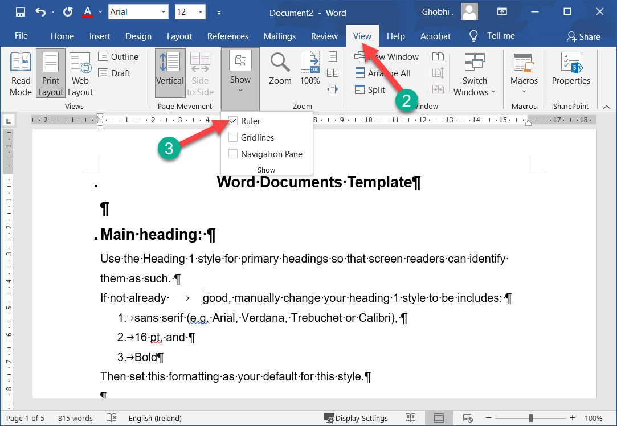
Enable Formatting Marks & Ruler
Click the View tab. |单击视图选项卡。
Check the Ruler check box in the Show group. |选中显示组中的标尺复选框。
The ruler appears above and to the left of the page.
标尺出现在页面的上方和左侧。

Slide 112
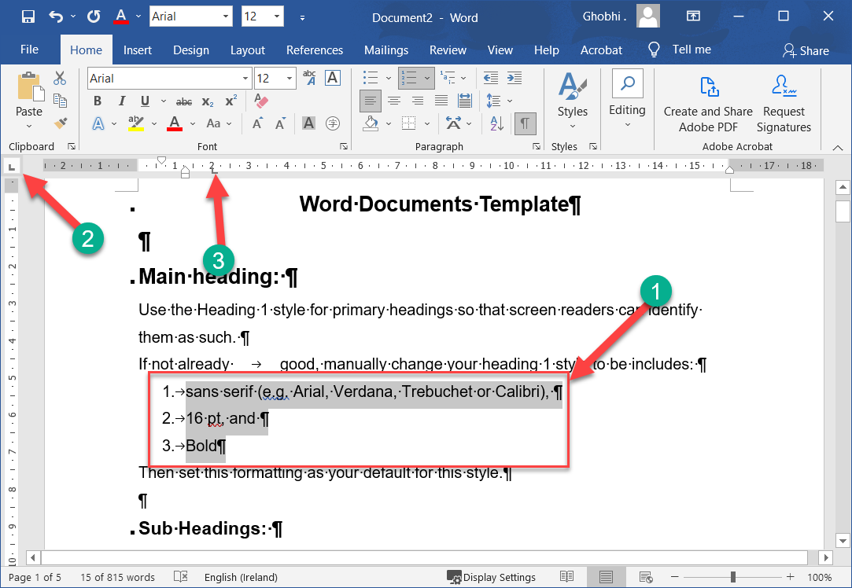
Set a Tab Stop Using the Ruler
Select the text you want to align. |选择要对齐的文本。
Select the type of tab stop you want to use. | 选择要使用的制表位类型。

Slide 113
Set a Tab Stop Using the Ruler
The tab icon at the upper-left shows the type of tab that's active. If you want something else, click the icon to cycle through the available options.
左上角的选项卡图标显示活动选项卡的类型。如果您需要其他内容，请单击该图标以在可用选项之间循环。

Slide 114
Set a Tab Stop Using the Ruler
Click on the ruler where you want to place the tab stop. The tab stop is added and everything after the tab is aligned to it.
单击要放置制表位的标尺。添加了制表位，并且制表符之后的所有内容都与其对齐。

Slide 115
Set a Tab Stop Using the Ruler
The tab icon at the upper-left shows the type of tab that's active.
左上角的选项卡图标显示活动选项卡的类型。
If you want something else, click the icon to cycle through the available options.
如果您需要其他内容，请单击该图标以在可用选项之间循环。

Slide 116
Set a Tab Stop Using the Ruler
Click on the ruler where you want to place the tab stop. The tab stop is added and everything after the tab is aligned to it. | 单击要放置制表位的标尺。添加了制表位，并且制表符之后的所有内容都与其对齐。

Slide 117

Types of Tab Stops
Symbol | Explanation | 解释
 | Aligns the left side of text with the tab stop. | 将文本的左侧与制表位对齐。
 | Aligns the text so that it’s centered under the tab stop. | 对齐文本，使其在制表位下方居中。
 | Aligns the right side of text with the tab stop. | 将文本的右侧与制表位对齐。

Slide 118
Types of Tab Stops
Symbol | Explanation
 | Aligns the left side of text with the tab stop. | 将文本的左侧与制表位对齐。
 | A vertical line character is inserted at the bar tab. | 在条形选项卡处插入一个竖线字符。

Slide 119
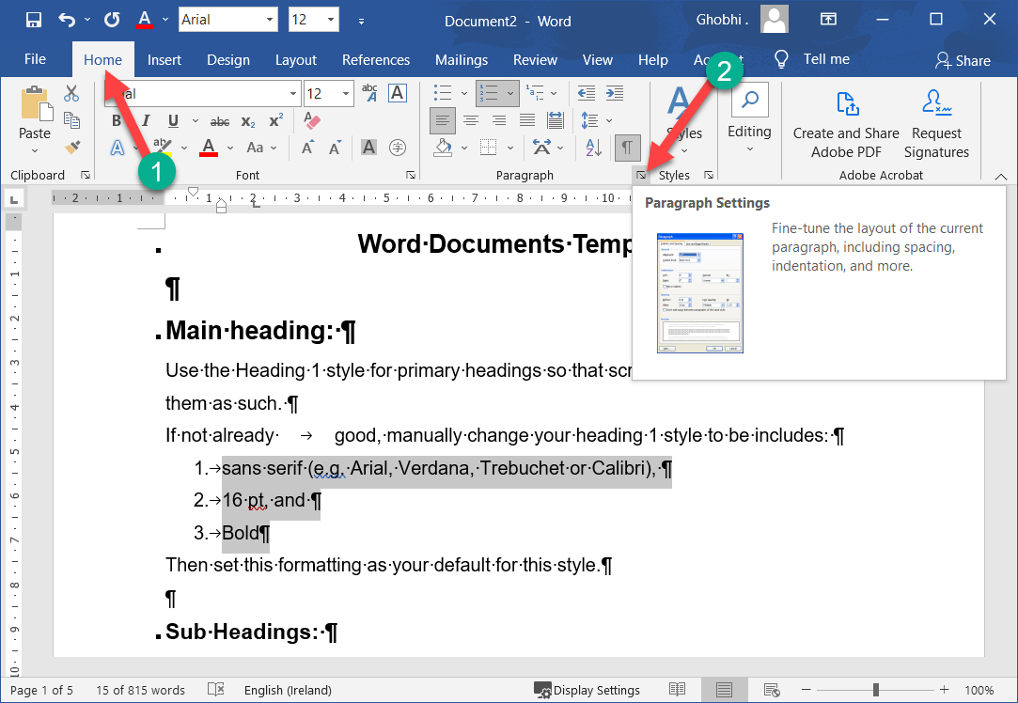
Set a Custom Tab Stop
If you want to create an additional tab at an exact location, you can use a custom tab stop.
如果要在确切位置创建附加选项卡，可以使用自定义制表位。
Click the Home tab. |单击主页选项卡。
Click the Paragraph dialog box launcher. | 单击段落对话框启动器。

Slide 120
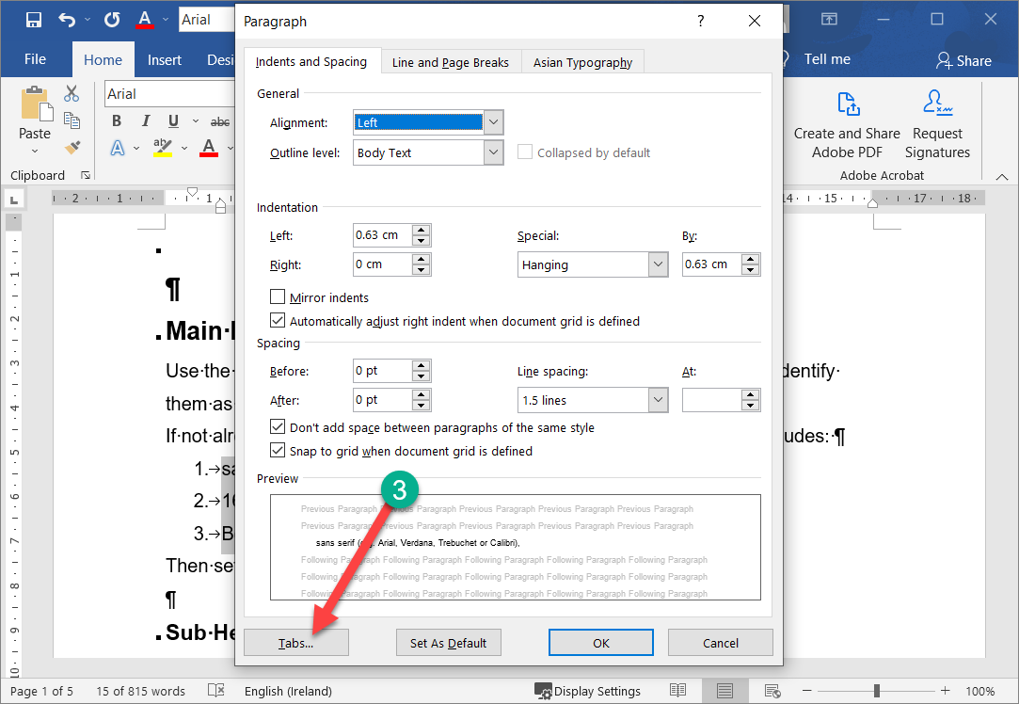
Set a Custom Tab Stop
Click Tabs. | 单击选项卡。

Slide 121
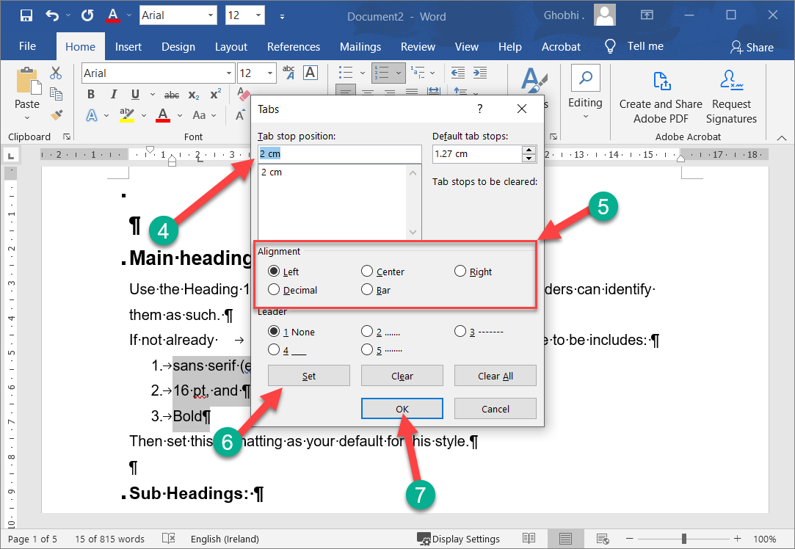
Set a Custom Tab Stop
Type a tab stop position. | 键入制表位位置。
Select the type of tab stop you want to use in the Alignment section. | 在对齐部分中选择要使用的制表位类型。

Slide 122
Set a Custom Tab Stop
You can set a tab leader here, which is a series of dots, dashes, or line that extends across the empty space added by a tab.
您可以在此处设置制表符前导符，它是一系列点、划线或线，它们延伸到制表符添加的空白区域。

Slide 123
Set a Custom Tab Stop
These are very helpful when you need to line up information across multiple lines, like in a directory or table of contents.
当您需要跨多行排列信息（例如在目录或目录中）时，这些非常有用。

Slide 124
Set a Custom Tab Stop
Click Set. | 单击设置。
The tab stop is added. You can repeat the process to add more tab stops.
添加了制表位。您可以重复该过程以添加更多制表位。

Slide 125
Set a Custom Tab Stop
Click OK. |单击确定。
The tab stops you set are added to the selected paragraph.
您设置的制表位将添加到所选段落中。

Slide 126
Set a Custom Tab Stop
Click the Clear button in the Tabs dialog box to remove a single tab stop or click the Clear All button to remove all tab stops.
单击“选项卡”对话框中的“清除”按钮删除单个制表位，或单击“全部清除”按钮删除所有制表位。

Slide 127
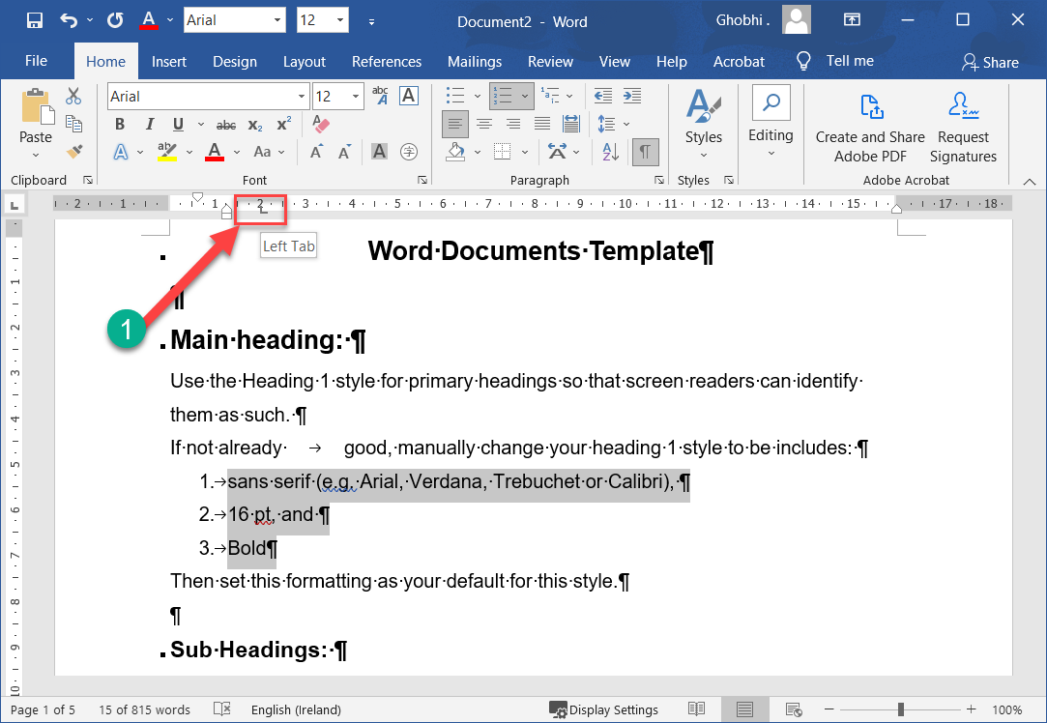
Move or Remove a Tab Stop
You can adjust a tab stop directly from the ruler, moving it to a new position or removing it entirely.
您可以直接从标尺调整制表位，将其移动到新位置或将其完全移除。

Slide 128
Move or Remove a Tab Stop
Click and drag a tab stop along the ruler to reposition it. |单击并沿标尺拖动制表位以重新定位它。
As you drag a tab stop to a new position on the ruler, the text affected by that tab stop will move with it.
当您将制表位拖动到标尺上的新位置时，受制表位影响的文本将随之移动。

Slide 129
Move or Remove a Tab Stop
Click and drag a tab stop off the ruler to remove it. |单击并将制表位拖离标尺以将其移除。
Removing a tab stop will shift the text over to the next tab stop.
删除制表位会将文本移到下一个制表位。

Slide 130
Move or Remove a Tab Stop
If another tab stop isn’t set, the text will instead use the default half-inch tab spacing.
如果未设置另一个制表位，文本将改为使用默认的半英寸制表间距。

Slide 131
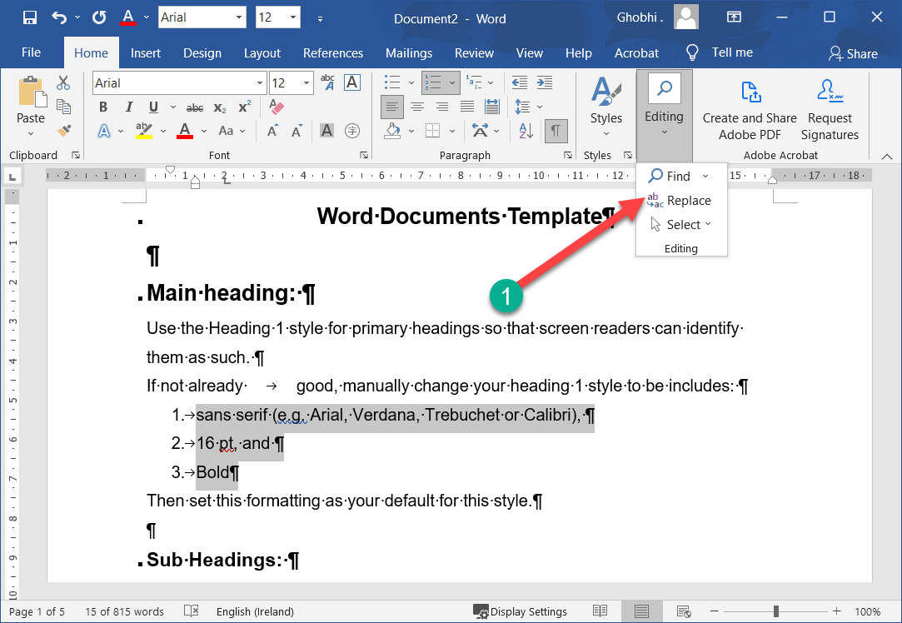
Find & Replace Formatting
If you have a lot of text throughout a document with the same formatting and it all needs to be updated, save yourself some time by using the find and replace formatting feature.
如果整个文档中有大量具有相同格式的文本并且都需要更新，请使用查找和替换格式功能节省一些时间

Slide 132
Find & Replace Formatting
Click the Replace button on the Home tab. | 单击主页选项卡上的替换按钮。

Slide 133
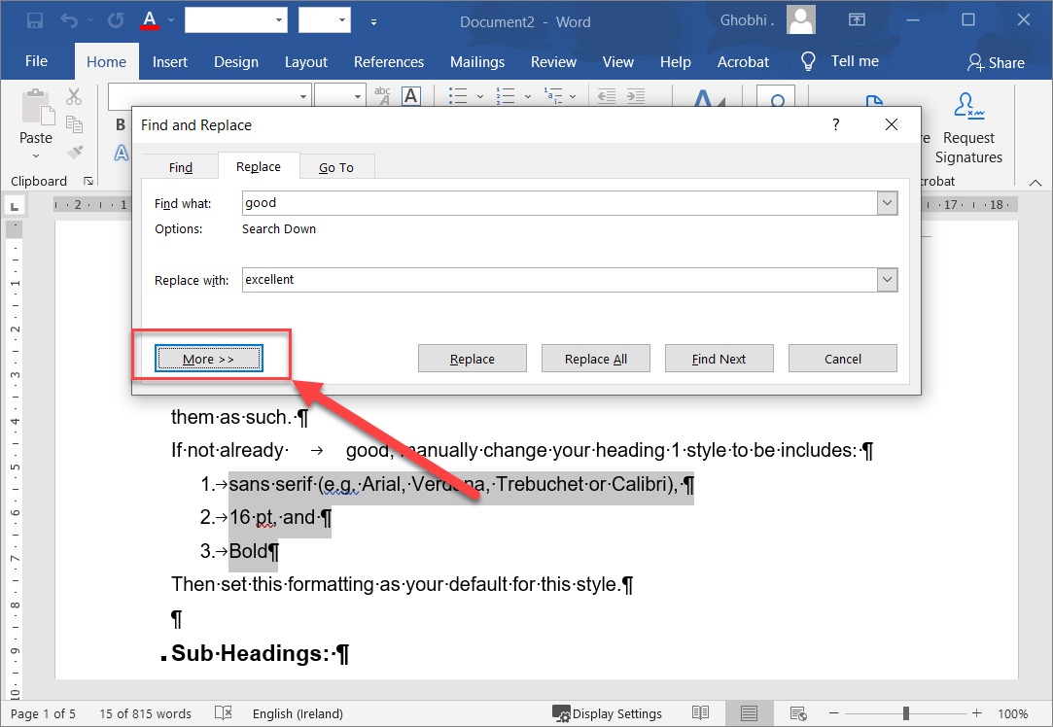
Find & Replace Formatting
Click More to expand the dialog box. | 单击“更多”以展开对话框。

Slide 134

Find & Replace Formatting
Click the Format button. | 单击格式按钮。
A list of different formatting types appears. You can search by font, paragraph, tab, language, frame, style, or highlight formatting.
出现不同格式类型的列表。您可以按字体、段落、选项卡、语言、框架、样式或突出显示格式进行搜索。

Slide 135
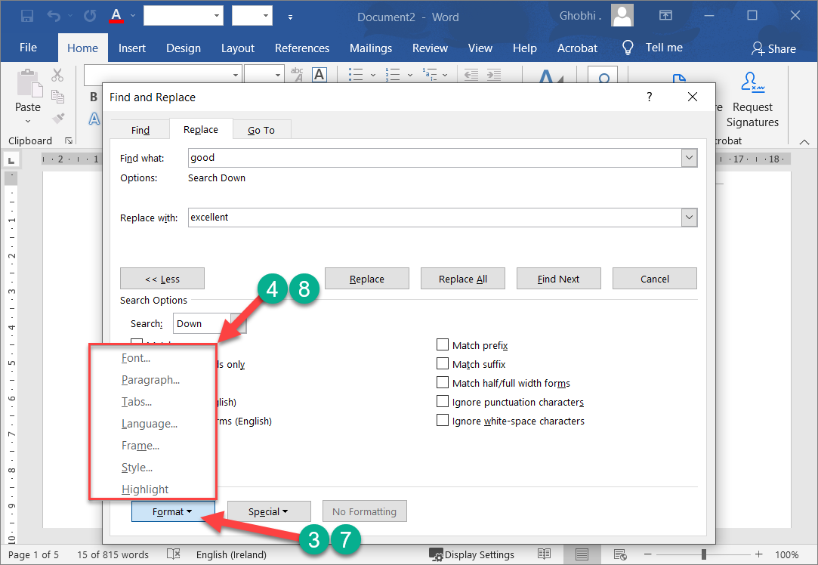
Find & Replace Formatting
Select the type of formatting you want to replace. | 选择要替换的格式类型。
A dialog box opens, showing all the formatting options available to search for in that category.
将打开一个对话框，显示可在该类别中搜索的所有格式选项。

Slide 136
Find & Replace Formatting
For example, the Find Font dialog box is basically a copy of the Font Formatting dialog box, with all the same formatting options available.
例如，“查找字体”对话框基本上是“字体格式”对话框的副本，具有所有相同的格式选项可用。

Slide 137
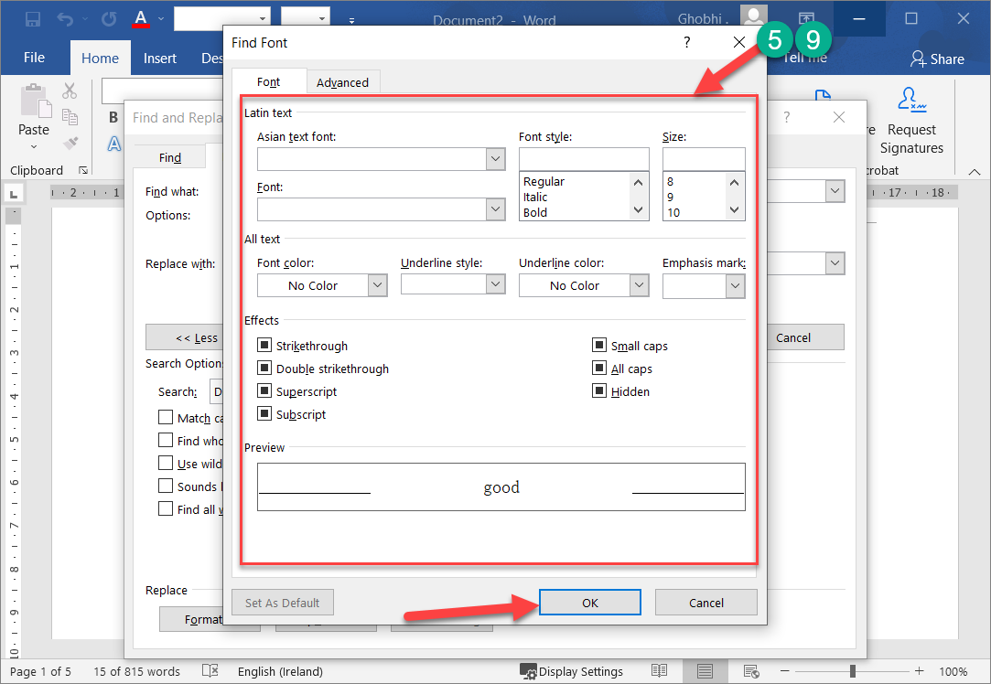
Find & Replace Formatting
Specify the formatting you want to replace and click OK. |指定要替换的格式，然后单击“确定”。
You can repeat these steps to find additional types of formatting.
您可以重复这些步骤以查找其他格式类型。

Slide 138
Find & Replace Formatting
For instance, you can search for text with both specific font formatting and paragraph formatting at once.
例如，您可以同时搜索具有特定字体格式和段落格式的文本。

Slide 139
Find & Replace Formatting
Once you’ve specified all the formatting you want to find, repeat these steps for the formatting to replace it with.
指定要查找的所有格式后，请对要替换的格式重复这些步骤。

Slide 140
Find & Replace Formatting
Click in the Replace With field. | 单击替换为字段。
Click the Format button again. | 再次单击格式按钮。

Slide 141
Find & Replace Formatting
Select the type of formatting you want to replace. |选择要替换的格式类型。
Specify the formatting options you want to apply and click OK. |指定要应用的格式选项，然后单击“确定”。

Slide 142
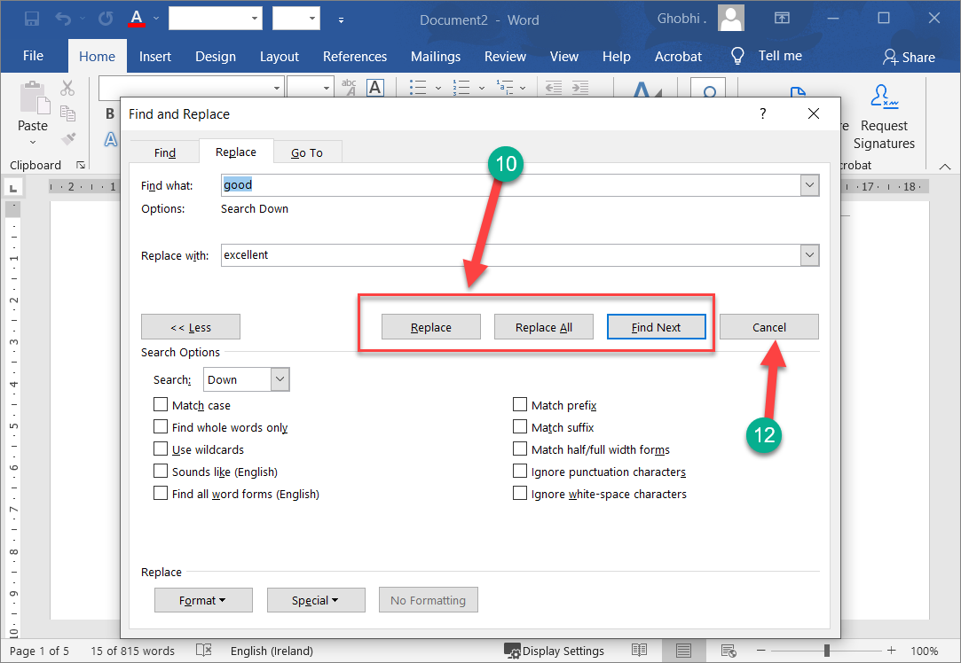
Find & Replace Formatting
Select a replacement option. |选择替换选项。
Replace: Replace just the first item found. Continue clicking Replace to keep replacing instances of formatting.
替换：只替换找到的第一个项目。继续单击替换以继续替换格式实例。

Slide 143
Find & Replace Formatting
Replace All: Replace all instances at once.
全部替换：一次替换所有实例。
Find Next: Skip to the next item found without replacing the currently selected one.
查找下一个：跳到找到的下一个项目，而不替换当前选择的项目。

Slide 144
Find & Replace Formatting
Once you have either replaced or skipped all the instances of the formatting you searched for, Word will show a dialog box, informing you that the search is complete.
替换或跳过搜索的所有格式实例后，Word 将显示一个对话框，通知您搜索已完成。

Slide 145
Find & Replace Formatting
Click OK. |单击确定。
Click the Close button. |单击关闭按钮。
The Find and Replace dialog box closes.
“查找和替换”对话框关闭

Slide 146

Thank You!
Social Health Growth
200 Jalan Sultan #03-17, Textile Centre, Singapore 199018
Hotline: (65) 9751 6906, Fax: (65) 6338 2892
SHG is a registered Charity with Ministry of Social and Family Development
Website: www.socialhealthgrowth.org
Facebook: facebook.com/socialhealthgrowth.shg
Twitter: @SHG_Singapore
Instagram: socialhealthgrowth

